Slide 1

Federal Drug-Free Workplace Program
Briefing
Missile Defense Agency
October 26, 2021
Hyden S. Shen and Anastasia Donovan
Federal Drug-Free Workplace Program
Department of Health and Human Services
Notes:
Hi everyone. My name is Anastasia Donovan and it’s great to be here virtually with you all. Today I’ll be giving you a brief history of the Federal Drug-Free Workplace Program so that you will have a better understanding of how it came into existence within your agency as it is today. And then I will turn it over to my coworker, Hyden Shen, who will present on the current initiatives and the future of the Program.

Slide 2

Federal Drug-Free Workplace Program
The Division of Workplace Programs (DWP) manages the statutory and regulatory aspects of the Federal Drug-Free Workplace Program (DFWP) on behalf of the Office of National Drug Control Policy (ONDCP) within the Executive Office of the President.
Notes:
The Federal Drug-Free Workplace Program has been in existence for 30+ years and is a drug prevention program that covers all federal executive branch agencies. The Division of Workplace Programs, where Hyden and I work, manages the statutory and regulatory aspects of the Drug-Free Workplace Program on behalf of the Office of National Drug Control Policy (or ONDCP).

Slide 3
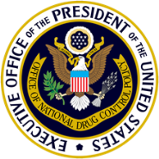


Drug-Free Workplace Program Impact
Federal Executive Branch
Approximately 150 Departments and Agencies
Civilian Employees
2 million +
Random Testing Positions (Safety/Security/Public Health) 400K+
Department of Transportation
(Federally regulated program that uses DWP’s drug testing
standards)
Regulated Transportation Industry Employees Tested
for Drugs (and Alcohol)
12 million +
Nuclear Regulatory Commission
Power Plants
100
Research and Test Reactors
36
(Federally regulated program that uses DWP’s drug testing standards)
DFWP Program Impacts 14 million⁺ employees
Notes:
This Program impacts around 14 million employees across approximately 150 agencies and the regulated industry, including the Department of Transportation and Nuclear Regulatory Commission.

Slide 4
Federal Drug-Free Workplace Program
Governing Authorities
Executive Order 12564
Public Law 100-71
Mandatory Guidelines
Guidance Documents
Model Plan for a Comprehensive Drug-Free Workplace Program
2013 Guidance for Selection of Testing Designated Positions
Notes:
The Federal Drug-Free Workplace Program has 5 key documents that serve as the basis for the Program.
There are 3 governing authorities that lay the foundation for and guide the program: they are Executive Order 12564, Public Law 100-71, and the Mandatory Guidelines.
The other 2 documents are the Model Plan and the Guidance for Selection of Testing Designated Positions. These 2 guidance documents help to standardize the program throughout all executive branch agencies.

Slide 5
Executive Order 12564
Directed Agency Heads to develop a plan to include:
“The mark of a successful drug-free workplace program also depends on how well the [Agency] can inform its employees of the hazards of drug use, and on how much assistance it can provide drug users.”
    Policies/procedures for a drug free workplace
    Employee Assistance Program
    Supervisory Training
    Employee Training
    Self Referrals to Treatment
    Drug Testing Program – Sensitive/Voluntary Positions
Notes:
5
14
In 1986, then President Ronald Reagan stated that the federal government, as the largest employer in the nation, can and should show the way towards achieving a drug-free workplace. Executive Order 12564 was created to help drug users refrain from using illegal drugs, as well as demonstrate that illegal drug use will not be tolerated in the federal workplace.
This executive order directed Agency Heads to create:
-policies and procedures for their Drug Free Workplace Programs
-Employee Assistance Program
-Supervisory and Employee training and education; because you can’t hold employees responsible for something they don’t know or understand.
-this executive order also allowed for self referrals to treatment in the case that employees wanted to seek help with their illegal drug use
-and finally, this executive order created the drug testing program, which allows for the drug testing of all executive branch employees

Slide 6
Public Law 100-71 and Mandatory Guidelines
Prohibited spending of appropriated funds for drug testing unless:
    Agency plan is certified by HHS and reported to Congress
Required HHS to publish Mandatory Guidelines that:
    Establish laboratory procedures, technologies, chain of custody
    Specify drugs for which employees may be tested
    Establish laboratory certification standards and processes (NLCP)
Notes:
After the Executive Order was signed, there was a lot of activity among the agencies to put together their programs. However, Congress noticed that there was a lack of standardization among the agencies. In order to ensure consistency throughout the program, Congress passed Public Law 100-71, which prohibited agencies from spending appropriated funds for drug testing unless their agency plans are certified by HHS and reported to congress.
It also required HHS, our office, to publish the Mandatory Guidelines, which establishes the scientific and technical aspects of the Program. These Guidelines come into play as soon as you step into the collection site. They standardize the laboratory procedures and electronic chain of custody, specify the drug to be tested for, and set laboratory certification standards through the National Laboratory Certification Program (or NLCP).

Slide 7
Guidance Documents
The Model Plan for a Comprehensive Drug-Free Workplace Program:
Serves as the basic foundation for the development of all Certified Plans
Each agency plan is unique - Shaped to address unique mission and structure of each agency
2013 Guidance for Selection of Testing Designated Positions:
Assists in the selection of Testing Designated Positions
Notes:
The Model Plan is used by all Executive Branch agencies as a template to help them create their DFWP plan. However, since each agency’s mission and structure are unique, not one DFWP plan is exactly like another, though there are similarities.
The Guidance for Selection of Testing Designated Positions is used to help your Drug Program Coordinator select the Testing Designated Positions within your agency.

Slide 8

Drug Program Coordinator
The Drug Program Coordinator (DPC) is responsible for implementing, directing, administering, and managing the drug program within the agency.
The DPC serves as the principal point of contact with the laboratory and for collection activities to assure the effective operation of the testing portion of the program.
An effective and successful DFWP requires support of staff at every level.
Notes:
The Drug Program Coordinator oversees the day-to-day implementation of this Program within each agency and responsible for directing, administering, and managing the drug program.
The DPC serves as the principal point of contact with the laboratory and for collection activities to assure the effective operation of the testing portion of the program.
Even though the DPC is the central point of contact for the DFWP, this program also relies on the participation and support of all employees at every level.

Slide 9
Drug Testing Panel
1) Cocaine
2) Amphetamines
3) Marijuana
Hydrocodone
4) Phencyclidine (PCP)
5) Opioids
Hydromorphone
Oxycodone
Oxymorphone
Note: If the Agency desires to add any other drug to its drug testing panel, advance written approval from the Secretary, Department of Health and Human Services is required. However, the Agency may test for any other Schedule I or Schedule II drug on a case-by-case basis.
Notes:
Now I’m going to switch gears and give you some background on the science aspect of this program.
Currently, the DFWP tests for the following Schedule I and Schedule II drugs: cocaine, amphetamines, marijuana, PCP, and Opioids. On October 1st, 2017, the updates to the urine Mandatory Guidelines were implemented and now allow for the testing of 4 opioids, or prescription drugs, that we have seen a high potential of abuse, and these are hydrocodone, hydromorphone, oxycodone, and oxymorphone. This program is a drug prevention program and does not test for alcohol.
We’re constantly working with our subject matter experts in the field to continue to update the drug testing panel to include emerging drugs.
In the event that the agency would like to add any other drugs to its routine drug testing panel, they can submit a request to the HHS Secretary for approval. But the agency is allowed to test for any other Schedule I or Schedule II drug on a case-by-case basis.

Slide 10
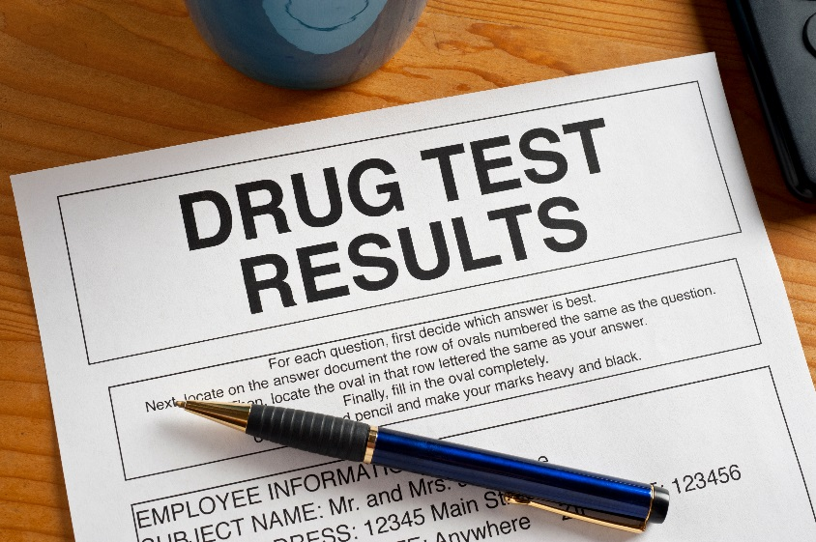
Types of Drug Testing
  Applicant
  Reasonable Suspicion
  Post Accident
  Follow-up - Counseling
  or Rehabilitation
  Voluntary
  Random - Testing Designated Positions (TDPs) only
Notes:
There are several different types of drug tests that are conducted under the program.
-For applicant testing, the agency can test all applicants that apply for all positions within the agency. This is to help reduce the instances of illegal drug use within the federal government.
-reasonable suspicion testing allows the agency to drug test any employee, not just those in Testing Designated Positions, if the agency finds cause that an employee is misusing illegal drugs.
-The agency can also drug test employees who caused accidents where there were injuries or substantial damages. This is known as post accident testing.
-the employee is also drug tested after he or she obtains counseling or rehabilitation for illegal drug use to ensure that he or she has remained drug free.
-the employee also has the option to volunteer to be drug tested
-lastly,there’s random drug testing, which applies only to those in Testing Designated Positions (or TDPs). A TDP is any position within the agency where a momentary lapse in judgment could result in a catastrophic consequence that cannot be remediated by the administrative process. One of the justifications for being placed in a TDP is a Secret and above security clearance. Here at MDA, all positions are classified with Secret or above clearances, and therefore are all subject to random testing.

Slide 11

What is a random testing program?*
The unscheduled, unannounced drug testing process imposed without individualized suspicion, designed to ensure that selections are made in a nondiscriminatory manner.
* Only applies to Testing Designated Positions
Notes:
So what is a random testing program? A truly random program is “The unscheduled, unannounced drug testing process which is imposed without individualized suspicion, and it is designed to ensure that selections are made in a nondiscriminatory manner.”
To put “random” into layman’s terms – when you roll a 6-sided dice, you have a 1 on 6 chance of landing on a specific number. If you were to land on the number “6” on the first roll, you would have the same probability of rolling a “6” on each consecutive roll. This is the same for random testing. Once your name gets pulled during a random selection, it goes right back into the testing pool, and it has the same probability of getting pulled every time a random selection is made.

Slide 12

National Laboratory Certification Program
  All DFWP drug tests are sent to HHS certified laboratories*
  Ensures standardization and consistency throughout the laboratory testing program
* HHS Certified Laboratory List: http://www.samhsa.gov/workplace/resources/drug-testing/certified-lab-list
Notes:
The Program has implemented a number of checks and balances to ensure the integrity of the DFWP. One key aspect is the oversight of the collection, testing, and reporting process through the National Laboratory Certification Program (or NLCP). The NLCP was established by the Mandatory Guidelines and is managed by the Division of Workplace Programs. Its purpose is to certify laboratories to conduct drug testing for federal agencies. This ensures standardization and consistency throughout the laboratory testing program. The specimens provided from your Program are all sent to these HHS-certified labs, all of which must follow the Mandatory Guidelines for drug testing.

Slide 13
Subversion Products
Three categories:
  Detoxifying Products – Drinks or tablets taken before drug test to rid the body of drugs
  Substitution Products – Synthetic clean urine used in place donor’s urine
  Adulterant Products – Liquids, crystals, mouth wash, or gum used to alter donor’s specimen so that drugs are no longer detectable
Notes:
Even though this program has been in existence for 30 plus years, there are still individuals out there who try to subvert the process. There are individuals who may try to use subversion products to subvert their drug tests, and these products can be found quickly and easily on dozens of websites. However, given that this is a well-established program, and the science has been fully developed we are able to detect these subversion products and they don’t work.
There are three main categories of subversion products for drug testing. Detoxifying products are usually teas or tablets that the donor will take days, weeks, or months before their test and they are supposed to clean the body of any drugs.
Substitution products are usually, but not limited to, synthetic, clean urine that the donor will try to use in place of his or her own urine.
Lastly, adulterant products are used to alter the donor’s specimen so that drugs are no longer detectable. Examples of these are liquids or crystals poured into the donor’s specimen, or adulterant mouth washes or gums the donor uses in his or her mouth before testing.

Slide 14
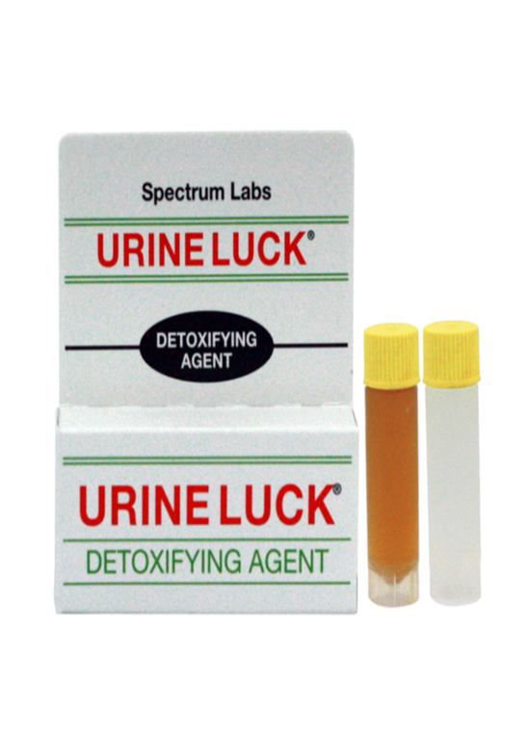
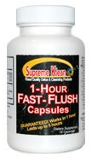

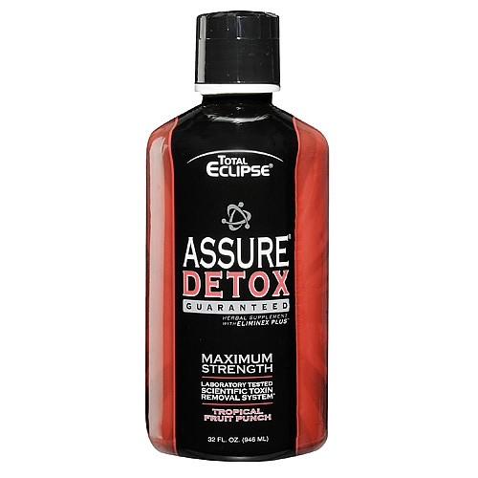



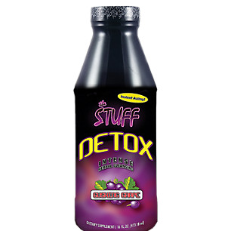
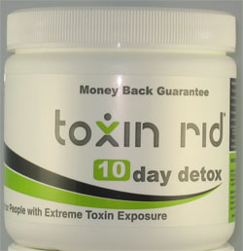


Subversion Product Examples
Notes:
These are just some examples of the subversion products that are out there.
So, what happens if these products are detected at the time of collection?
If the specimen that is collected looks like it has been tampered with, or the donor acted in such a way that suggested that he or she tampered with the specimen, another specimen will be collected under direct supervision of the collector.
Then, both specimens are sent to HHS-certified labs where the lab tests them for adulterants or substitutions. If the lab is able to confirm that the specimen was tampered with or adulterated in some way, they will report the result of the test to the Medical Review Officer (or MRO) as a “refusal to test.” The MRO will then notify the Agency, and the agency leadership will take disciplinary action, which could lead to automatic termination of employment.

Slide 15

Medical Review Officer
15
  Licensed Physician – M.D. or Doctor of Osteopathy
  Knowledge of pharmacology and toxicology of illicit drugs
  Certified as a Medical Review Officer
  Final say in determining positive drug test result
Notes:
The Medical Review Officer (or MRO) is a licensed physician with knowledge of pharmacology and toxicology of illicit drugs and is certified to be an MRO. The MRO has the final say in determining a positive drug test result under the DFWP. If the MRO verifies a positive drug test result, he or she will notify the agency of the positive result, and the agency may take administrative action. Some examples of possible administrative actions can be:
placing the employee on enforced leave status,
suspending the employee,
reducing employee in pay or grade, or
terminating the employee.
Check with your DPC for more information specific to MDA.
Now I’ll turn it over to my coworker, Hyden Shen, and he will present on the current initiatives and future direction of the Drug Free Workplace Program.

Slide 16
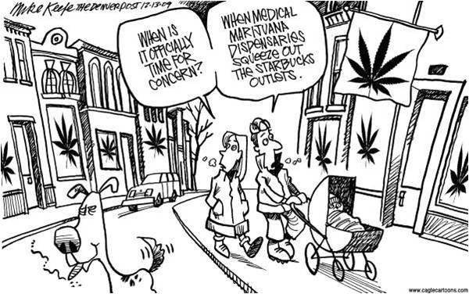
Marijuana
16

Slide 17
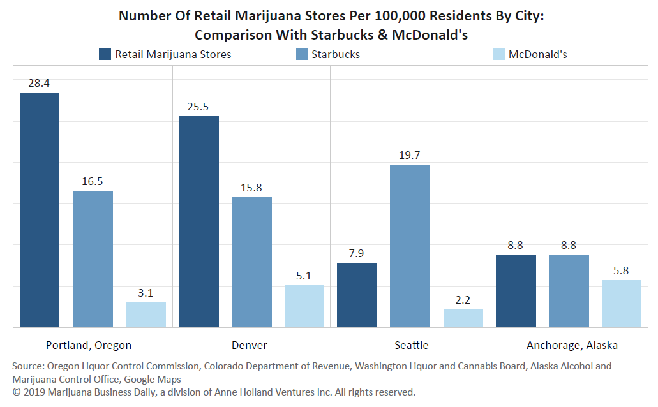
Marijuana vs. Starbucks and McDonalds
17

Slide 18
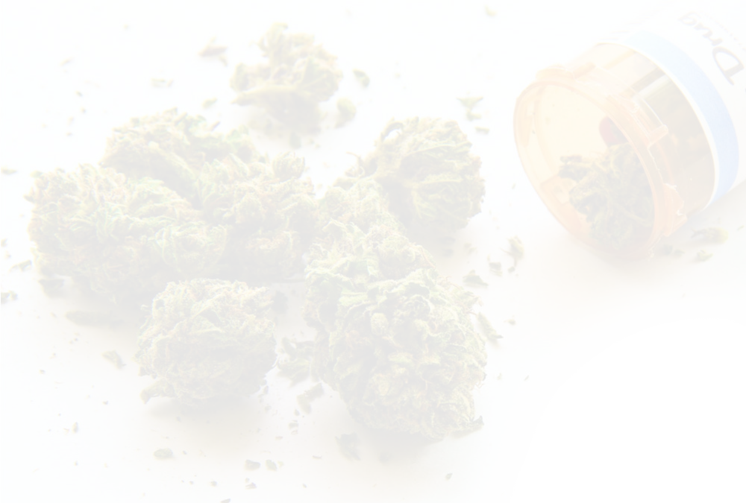
Marijuana - Clarification
18
States have passed medical and recreational marijuana initiatives.
Under the Controlled Substances Act, marijuana continues to be a Schedule I Drug
Marijuana continues to be tested under the Federal Drug Free Workplace Program.

Slide 19
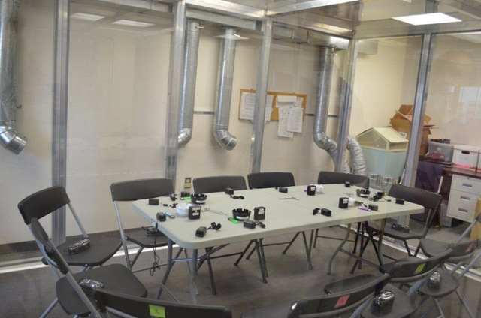
Passive Inhalation Study
Claims of positive drug test results due to passive inhalation
19
Constructed of plexiglass and aluminum
Dimensions: 10’ x 13’ x 7’ (W x L x H), 910 cu ft.
Sealed door closure
Optional no ventilation/ventilation comparable to A/C in home
Notes:
Tour bus example

Slide 20
Passive Inhalation Study
20
Six active smokers, six non-smokers per session
Smokers smoked as much as they wanted to without limitation in a “social-like” setting
Three exposure sessions:
  Session 1: smokers each smoke ad lib MJ cigarettes (5.3% THC) for one hour, no active air flow
  Session 2: smokers each smoke ad lib MJ cigarettes (11.3% THC) for one hour, no active air flow
  Session 3: smokers each smoke MJ ad lib MJ cigarettes (11.3% THC) for one hour, with active air flow simulating room air conditioning

Slide 21

Cannabis Edibles Study - Brownies
21
Increasing popularity of oral “Edible” cannabis products
  16-26% of medical cannabis users
  No combustion
  Longer time course of effects
Most controlled human cannabis research use smoked/inhaled route of administration
Federal organizations that regulate medicine food cannot regulate cannabis
(Courtesy of Ryan Vandrey, JHU)
Notes:
Brownie study.
10, 25, 50 mg of THC brownies.

Slide 22
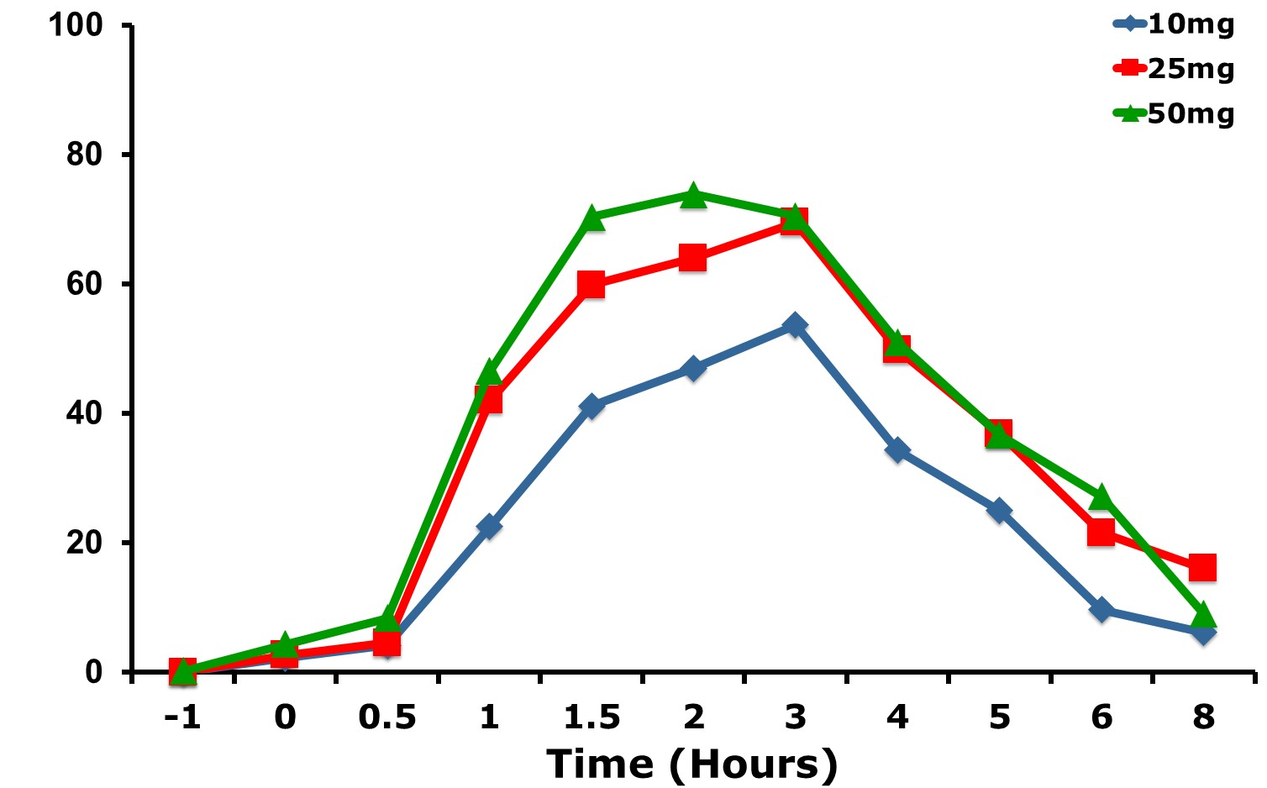
Edible Results: “Drug Effect”
22
Brownies
(Courtesy of Ryan Vandrey, JHU)
Notes:
Impact –instant high vs 1-3 hours later

Slide 23
2018 Agricultural Improvement Act (Farm Bill)
23
Farm Bill (signed into law on Dec. 20, 2018) - removed hemp from definition of marijuana within the Controlled Substances Act (CSA).
Marijuana remains a Schedule I drug under the CSA. There are no provisions under the DFWP that permit the use of marijuana or other Schedule I substances for medical reasons.
Memorandums providing guidance regarding hemp, CBD products, and marijuana use under DFWP can be found at https://www.samhsa.gov/workplace/workplace-programs
  2012 Memorandum Addressing Recreational Marijuana
  2017 Memorandum Addressing Cannabidiol (CBD)
  2019 Memorandum Farm Bill (Hemp)
  2020 Memorandum Addressing 2020 Election and Changes in State Drug Laws
Notes:
0.3% THC or less in dry weight = hemp

Slide 24
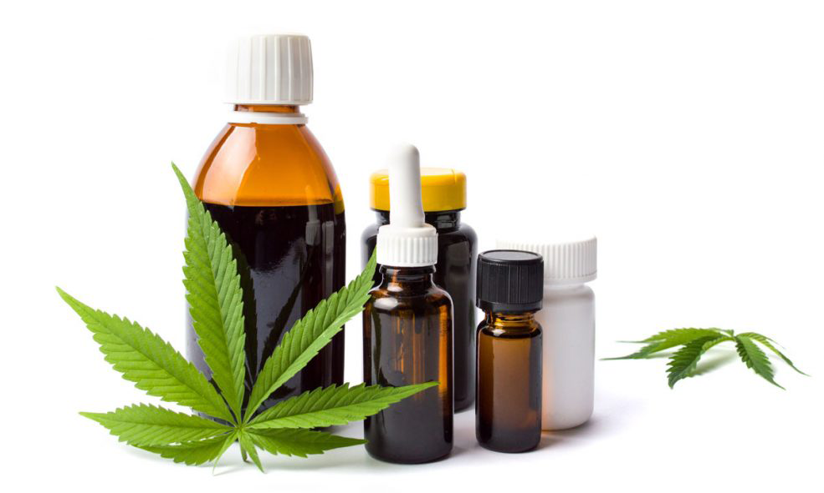
What is Cannabidiol (CBD)?
24
CBD is a key ingredient in marijuana
CBD is non-psychoactive

Slide 25
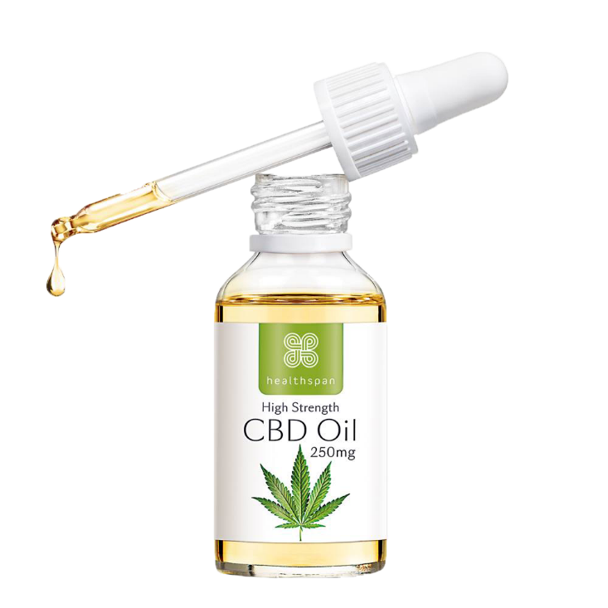
Clarification of the Problem with CBD Oils
Table 2. Observed Cannabinoid Concentration of 84 Tested Extract Products Sold Online
Notes:
FDA does not have authority or oversight over CBD or hemp products
Research has found that products claiming to be 100% THC-free actually contained upwards of 6.4 mg/mL of THC.
Of the 84 CBD products tested, 69% were inconsistent with the label
Since these products are not regulated by the FDA, you are taking a risk when using these products and could still test positive for marijuana due to potential THC in these products.
There is no legitimate explanation for testing positive for marijuana.

Slide 26
Mandatory Guidelines Update
26
Urine
Oral Fluid
Hair
Urine Mandatory Guidelines - Testing for 4 semi-synthetic opioids:
Hydrocodone
Hydromorphone
Oxycodone
Oxymorphone
Revised Urine Mandatory Guidelines published in Federal Register on January 23, 2017, with an implementation date of October 1, 2017.
Oral Fluid Mandatory Guidelines published in Federal Register on October 25, 2019, with an effective date of January 1, 2020.
Currently – No certified oral fluid drug testing lab(s) under the NLCP
Hair is being proposed as a specimen for drug testing.
SAMHSA published the proposed Hair Mandatory Guidelines in Federal Register on September 10, 2020, for public comment.
We are currently responding to public comments.

Slide 27
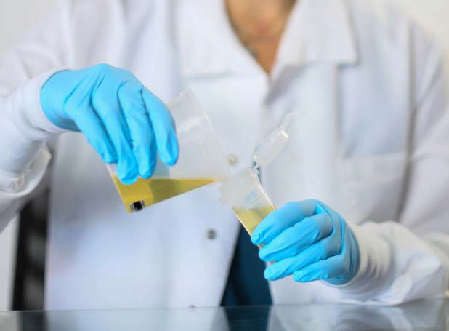
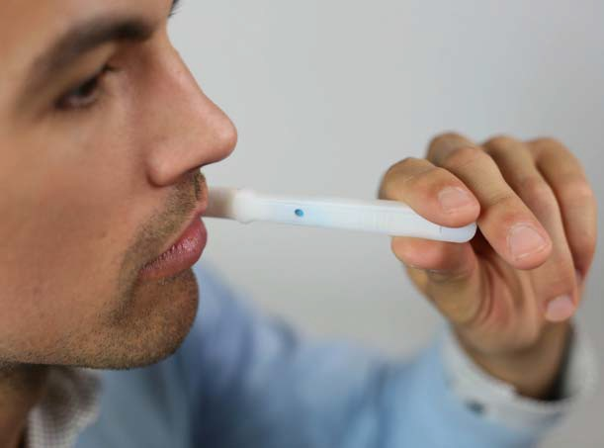

Common Matrices in Drug Testing
27
Detection windows vary by drug test type
Urine Drug Testing
Oral Fluid Drug Testing
Hair Drug Testing
Detects recent use (previous 24-72 hours)
Detects recent use (previous 24-48 hours)
Detects a pattern of repetitive use (up to 90 days, based on testing proximal 1.5” head hair)

Slide 28
DFWP and the Evolving Environment
28
Emerging Issues - Legislation
  2015 FAST Act – required development of Mandatory Guidelines for Hair testing while issues of hair color impact and external contamination issues continue to exist
  2018 Farm bill – defined hemp and set a legal limit for THC content
  2018 Opioids Crisis Response Act - addition of four semi-synthetic opioids
Changes in Science and Technology
  Drug testing and specimen collection technology are improving – Oral Fluid Mandatory Guidelines, effective January 1, 2020
  Possible addition of fentanyl and methadone to standard HHS drug panel
Evolving Environment
  New and novel drug use continues to emerge, e.g., synthetic designer drugs
  Increased public acceptability and availability of marijuana, CBD products, and THC isomers (e.g., delta-8-THC) with inevitable implications for workplace safety/security – e.g., State initiatives to de-schedule marijuana as a Schedule I drug
  Increased demands on the DFWP – e.g., COVID-19 return-to-office challenges
Notes:
With new emerging legislation, advances in science and technology, and an evolving environment SAMHSA will be examining the impact on policy and other aspects of the federal Drug Free Workplace Program. The need has become even more imperative as the effects of the COVID-19 pandemic have unfolded. To examine the program, a wide variety of stakeholders and experts will be convened to gather information and insight to assess the impact and future direction of the Drug Free Workplace Program.

Slide 29
Teleworking
29
Does an employee have a right to telework?
No. Telework is not a universal employee benefit or right. Federal law requires agencies to establish telework programs but does not give individual employees a legal right to telework.
Teleworking is not an acceptable deferral to drug testing. All employees are still subject to Drug-Free Workplace Program drug testing.
OPM FAQ - https://www.opm.gov/FAQs/topic/telework/index.aspx?start=0
Notes:
Teleworking is not an acceptable deferral to testing.
List 3 deferrals to testing:
official leave,
official travel, and
undercover assignment

Slide 30
Supervisor Training Module – Coming Soon!
Online training module on DFWP available soon for supervisors. Training topics will include:
  Understand and support Drug-Free Workplace Program
  Recognize and document workplace issues that may be related to drugs
  Address all employees (not just TDPs) with possible drug-related issues and initiate a drug test based on reasonable suspicion
  Remove employees with drug-related issues from safety sensitive positions and refer them to EAP services
  Encourage employees who have problems with drugs to voluntarily seek help
  Continue to supervise employees who have been referred for assistance
  Reintegrate employees back into workforce
Approximately 1 hour
Quiz

Slide 31


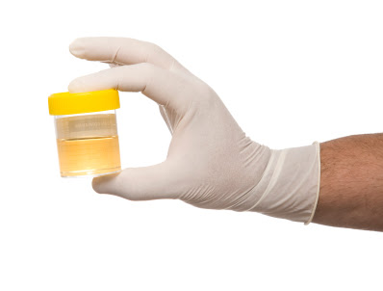


Drug-Free Workplace Program Oversight-
All aspects from start to finish
Agency Drug-Free Workplace Program Certified Plan:
Agency specific plan (Mission and Structure)
Model Plan for a Comprehensive DFWP
2013 Guidance for the Selection of Testing Designated Positions
Collection Process:
Trained collectors and the collection process
Collector’s Manual
Drug Testing:
National Laboratory Certification Program
Inspections
Medical Review Officer:
Medical Review Manual
Re-Certification Process
Agency:
Administrative Action (DFWP Certified Plan)

Slide 32
DFWP Resources
32
Division of Workplace Programs Main Website:
https://www.samhsa.gov/workplace
Executive Order 12564:
http://www.samhsa.gov/sites/default/files/executive_order.pdf
Public Law 100-71:
http://www.samhsa.gov/sites/default/files/workplace/public_law_100.pdf
Urine Mandatory Guidelines:
https://www.samhsa.gov/sites/default/files/workplace/frn_vol_82_7920_.pdf
Oral Fluid Mandatory Guidelines:
https://www.samhsa.gov/sites/default/files/programs_campaigns/division_workplace_programs/final-mg-oral-fluid.pdf
Model Plan for a Comprehensive Drug-Free Workplace Program:
http://www.samhsa.gov/sites/default/files/workplace/ModelPlan508.pdf
2013 Guidance for Selection of Testing Designated Positions:
https://www.samhsa.gov/sites/default/files/workplace/09-2013-guidance-selection-tdps-2-13-17.pdf

Slide 33
Drug-Free Workplace Program
Hyden S. Shen, J.D.
Policy Oversight Lead
Phone: 240-276-2600
Email: Hyden.Shen@samhsa.hhs.gov
Anastasia Donovan
Policy Analyst
Phone: 240-276-2600
Email: Anastasia.Donovan@samhsa.hhs.gov

Slide 34
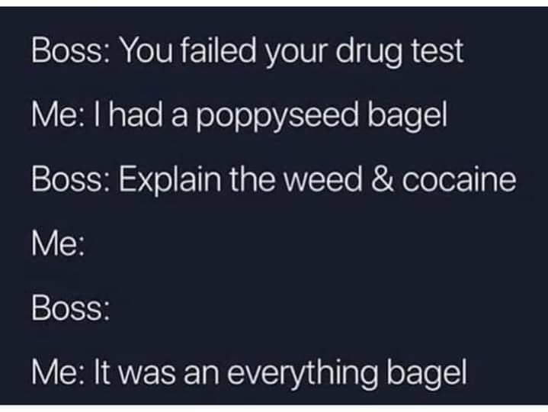
Questions
34

