Slide 1


LAT WELLNESS STUDIO
NEUROPLASTICITY AND EXERCISE
PRESENTED BY LAURIE ANDREWS

Slide 2

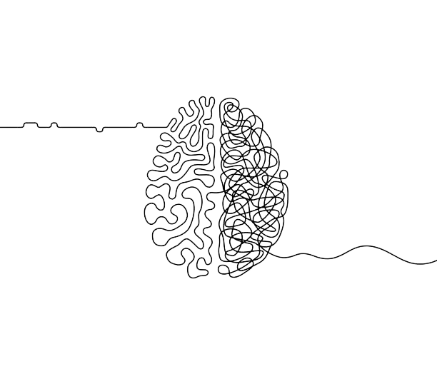
LAT WELLNESS
“’Neuroplasticity, also known as neural plasticity or brain plasticity, is a process that involves adaptive structural and functional changes to the brain. It is defined as the ability of the nervous system to change its activity in response to intrinsic or extrinsic stimuli by reorganizing its structure, functions, or connections after injuries, such as a stroke or traumatic brain injury (TBI)’ and even emotionally traumatic events.”
NIH, National Library of Medicine
WHAT IS
NEUROPLASTICITY

Slide 3
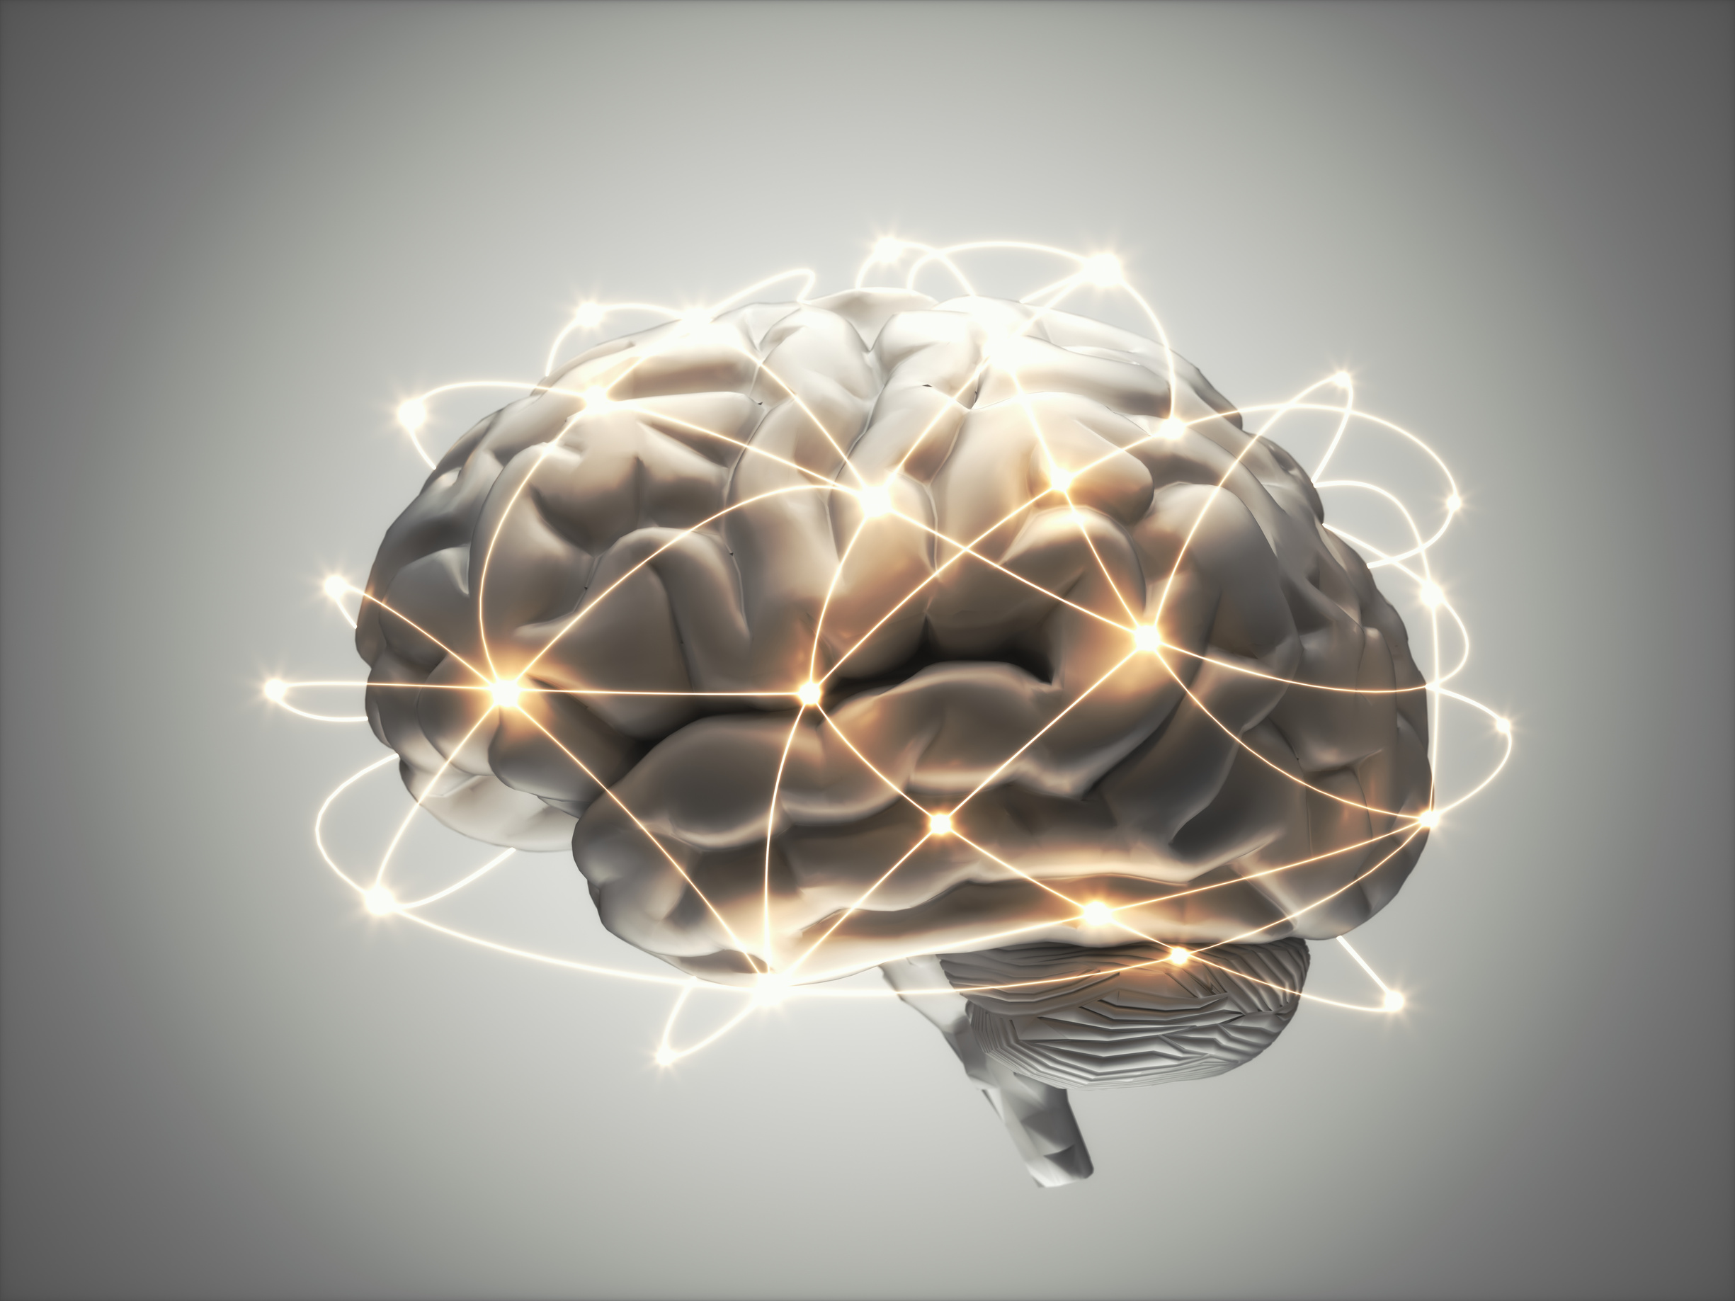
LAT WELLNESS
WHY SHOULD WE UNDERSTAND NEUROPLASTICITY?
The benefits are astounding.
Current research has proven that through certain activities and treatments, the adult brain is able to continue growing and shifting pathways to various parts of the brain. This can decrease risks of brain deteriorating diseases from TBI/Stroke, cure or decrease effects of anxiety/depression, and optimize memory retention.

Slide 4
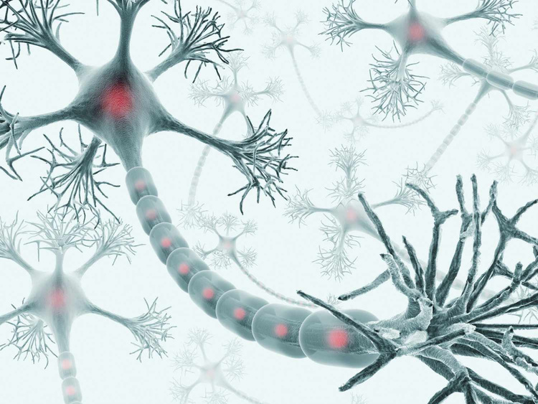

LAT WELLNESS
BENEFITS OF EXERCISE ON
BRAIN FUNCTION
Mental health
Neurons
More
Learning and memory
Motor function
Glial cells

Slide 5
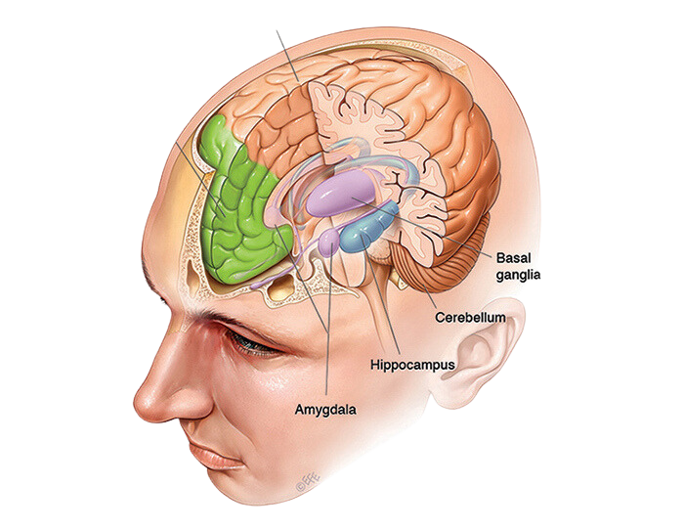
LAT Wellness
LEARNING AND MEMORY
The Activity
The Outcome
  Dance
  Martial Arts
  Balance
  Walking
  Strength Training
  “significant improvement in memory, attention, body balance, psychosocial parameters and altered peripheral neurotrophic factor” -NIH
  “improved the participant’s ability to focus and their processing speed, and their executive function”-NIH
  “increases cortical thickness in visual and vestibular cortical regions” - NIH
  “hippocampal neurogenesis, in which new neurons are generated and incorporated into hippocampal circuits” - NIH
  “resting-state EEG network is closely related to upper body grip strength, which can indirectly reflect an individual's muscle strength through the resting brain network” - NIH

Slide 6


LAT Wellness
MENTAL HEALTH
“Aerobic exercises, including jogging, swimming, cycling, walking, gardening, and dancing, have been proved to reduce anxiety and depression. These improvements in mood are proposed to be caused by exercise-induced increase in blood circulation to the brain and by an influence on the hypothalamic-pituitary-adrenal (HPA) axis and, thus, on the physiologic reactivity to stress. This physiologic influence is probably mediated by the communication of the HPA axis with several regions of the brain, including the limbic system, which controls motivation and mood; the amygdala, which generates fear in response to stress; and the hippocampus, which plays an important part in memory formation as well as in mood and motivation.” - NIH

Slide 7
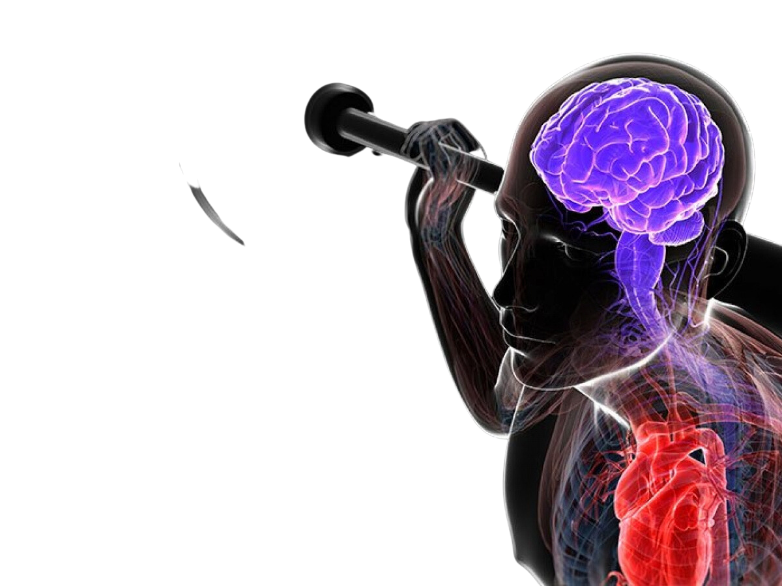
LAT Wellness
MOTOR FUNCTION
“Maintaining brain health and plasticity throughout life is an important public health goal, and the correlation between exercise and behavioral stimulation in supporting this achievement is clear. Indeed, research on human factors and physical activity suggests that exercise can maintain or even improve brain plasticity. Plasticity is here defined as the normal ongoing state of the nervous system throughout one’s life span, while behavior is the manifestation of the coordinated workings of the entire nervous system. Whereas exercise is the intentional engagement in physical activity in order to enhance fitness level, physical activity encompasses all forms of movement produced by skeletal muscles. Exercise, as a “stressor,” appears to be a powerful determinant of brain (neuro)physiology and can be viewed as a widely practiced behavior that activates molecular and cellular cascades which support and maintain brain plasticity. These changes are mediated by upregulation of several growth factors, including vascular endothelial grow factor, and brain-derived neurotrophic factor (BDNF) . BDNF is a key protein in regulating maintenance, growth, and even survival of neurons , and has been shown to be an important activity-dependent modulator of synaptic transmission and, in turn, of synaptic plasticity . Furthermore, BDNF appears to mediate exercise-induced neurogenesis, i.e., the process by which new neurons proliferate and develop .” - NIH

Slide 8
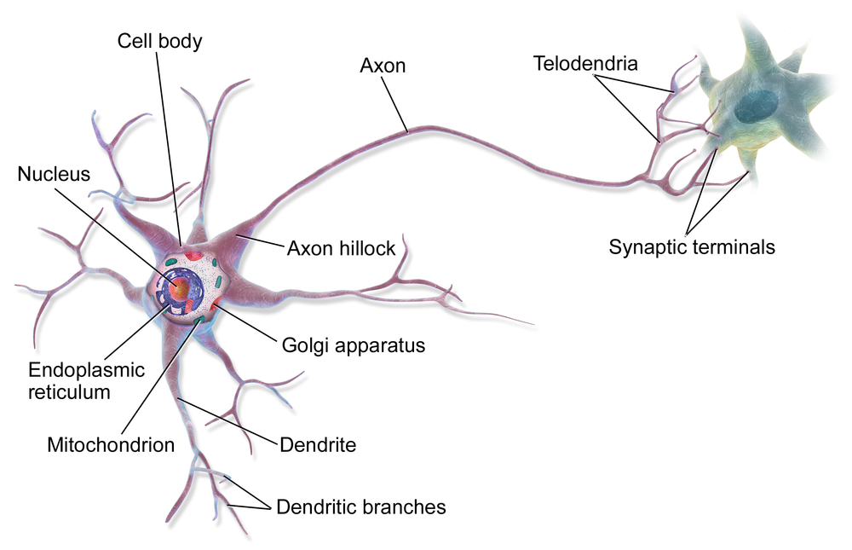

LAT Wellness
NEURONS
“Regular physical activity triggers the release of a protein called brain-derived neurotrophic factor (BDNF), which nurtures existing neurons and encourages the growth and development of new neurons and synapses.
Aerobic exercises like running and swimming are particularly beneficial. They not only stimulate neurogenesis but also increase the size of the anterior hippocampus, leading to improved spatial memory.
Moreover, they’ve been linked to the preservation of white and gray matter in the frontal, temporal, and parietal cortexes, areas that typically shrink with age and are vital for cognitive function.” -Neurosciencenews
06/12

Slide 9
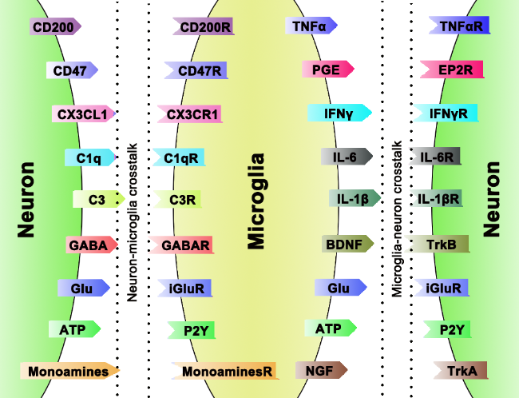
LAT Wellness
GLIAL CELLS
“Physical exercise improves brain functions by regulating glial activation in numerous CNS diseases, including AD, Parkinson’s Diseases and ischemic stroke. Physical exercise could activate cellular and molecular pathways contributing to neuroplasticity. Glial cells play a multifaceted and complex role in CNS diseases with their supportive effects on cell proliferation and brain plasticity. Neuroplasticity is found to be enhanced in the absence of microglia T cell interaction and microglia activation after exercise. Physical exercise inhibits neuroinflammation and microglial activation and modulates dopaminergic damages.”
- aginganddisease.org

Slide 10

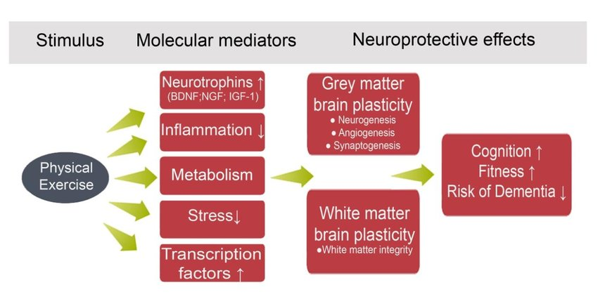
LAT Wellness
Physical Activity and Educational Achievement: Insights from Exercise Neuroscience
BRAIN FUNCTION+EXERCISE
STATISTICS

Slide 11
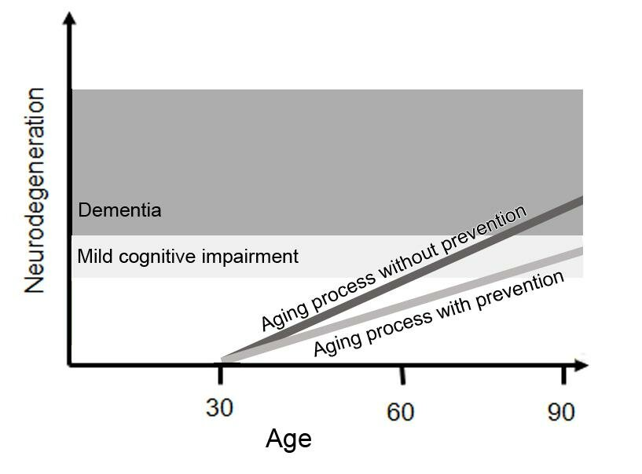
LAT Wellness
Physical Activity and Educational Achievement: Insights from Exercise Neuroscience
BRAIN FUNCTION+EXERCISE
STATISTICS

Slide 12

LAT Wellness
IN
CONCLUSION
Exercise is highly effective for ‘increasing the production of neurotrophic factors, cell growth, and proliferation, as well as for improving brain functionality.’ Adopting a regular exercise program significantly improves brain fuction. - NIH

Slide 13


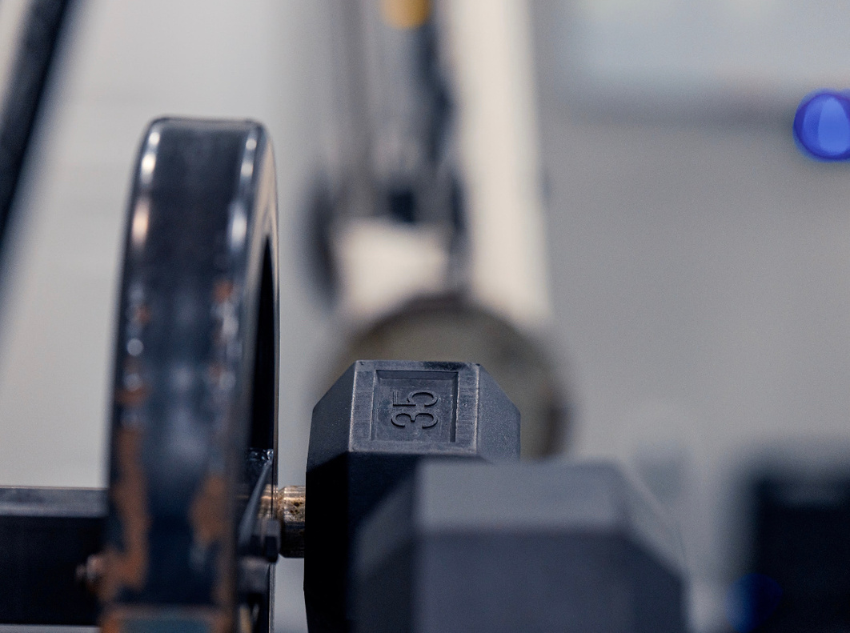
LAT Wellness
STAY
www.latpersonaltraining.com
LAT Wellness Studio
252-702-1749
laurieanntraining@gmail.com
IN TOUCH

