Slide 1
What are PMADs?
An Introductory Guide to the
#1 Complication of Pregnancy & Childbirth

Slide 2
Postpartum Support Virginia's Mission
To educate families, healthcare providers, and communities about Perinatal Mood & Anxiety Disorders (PMADs), provide resources to help perinatal people and their families overcome anxiety, depression, and other PMADs.

Slide 3
The Happiest Time in a Person's Life…
Notes:
3
Social media highlight reels exacerbate this misconception

Slide 4
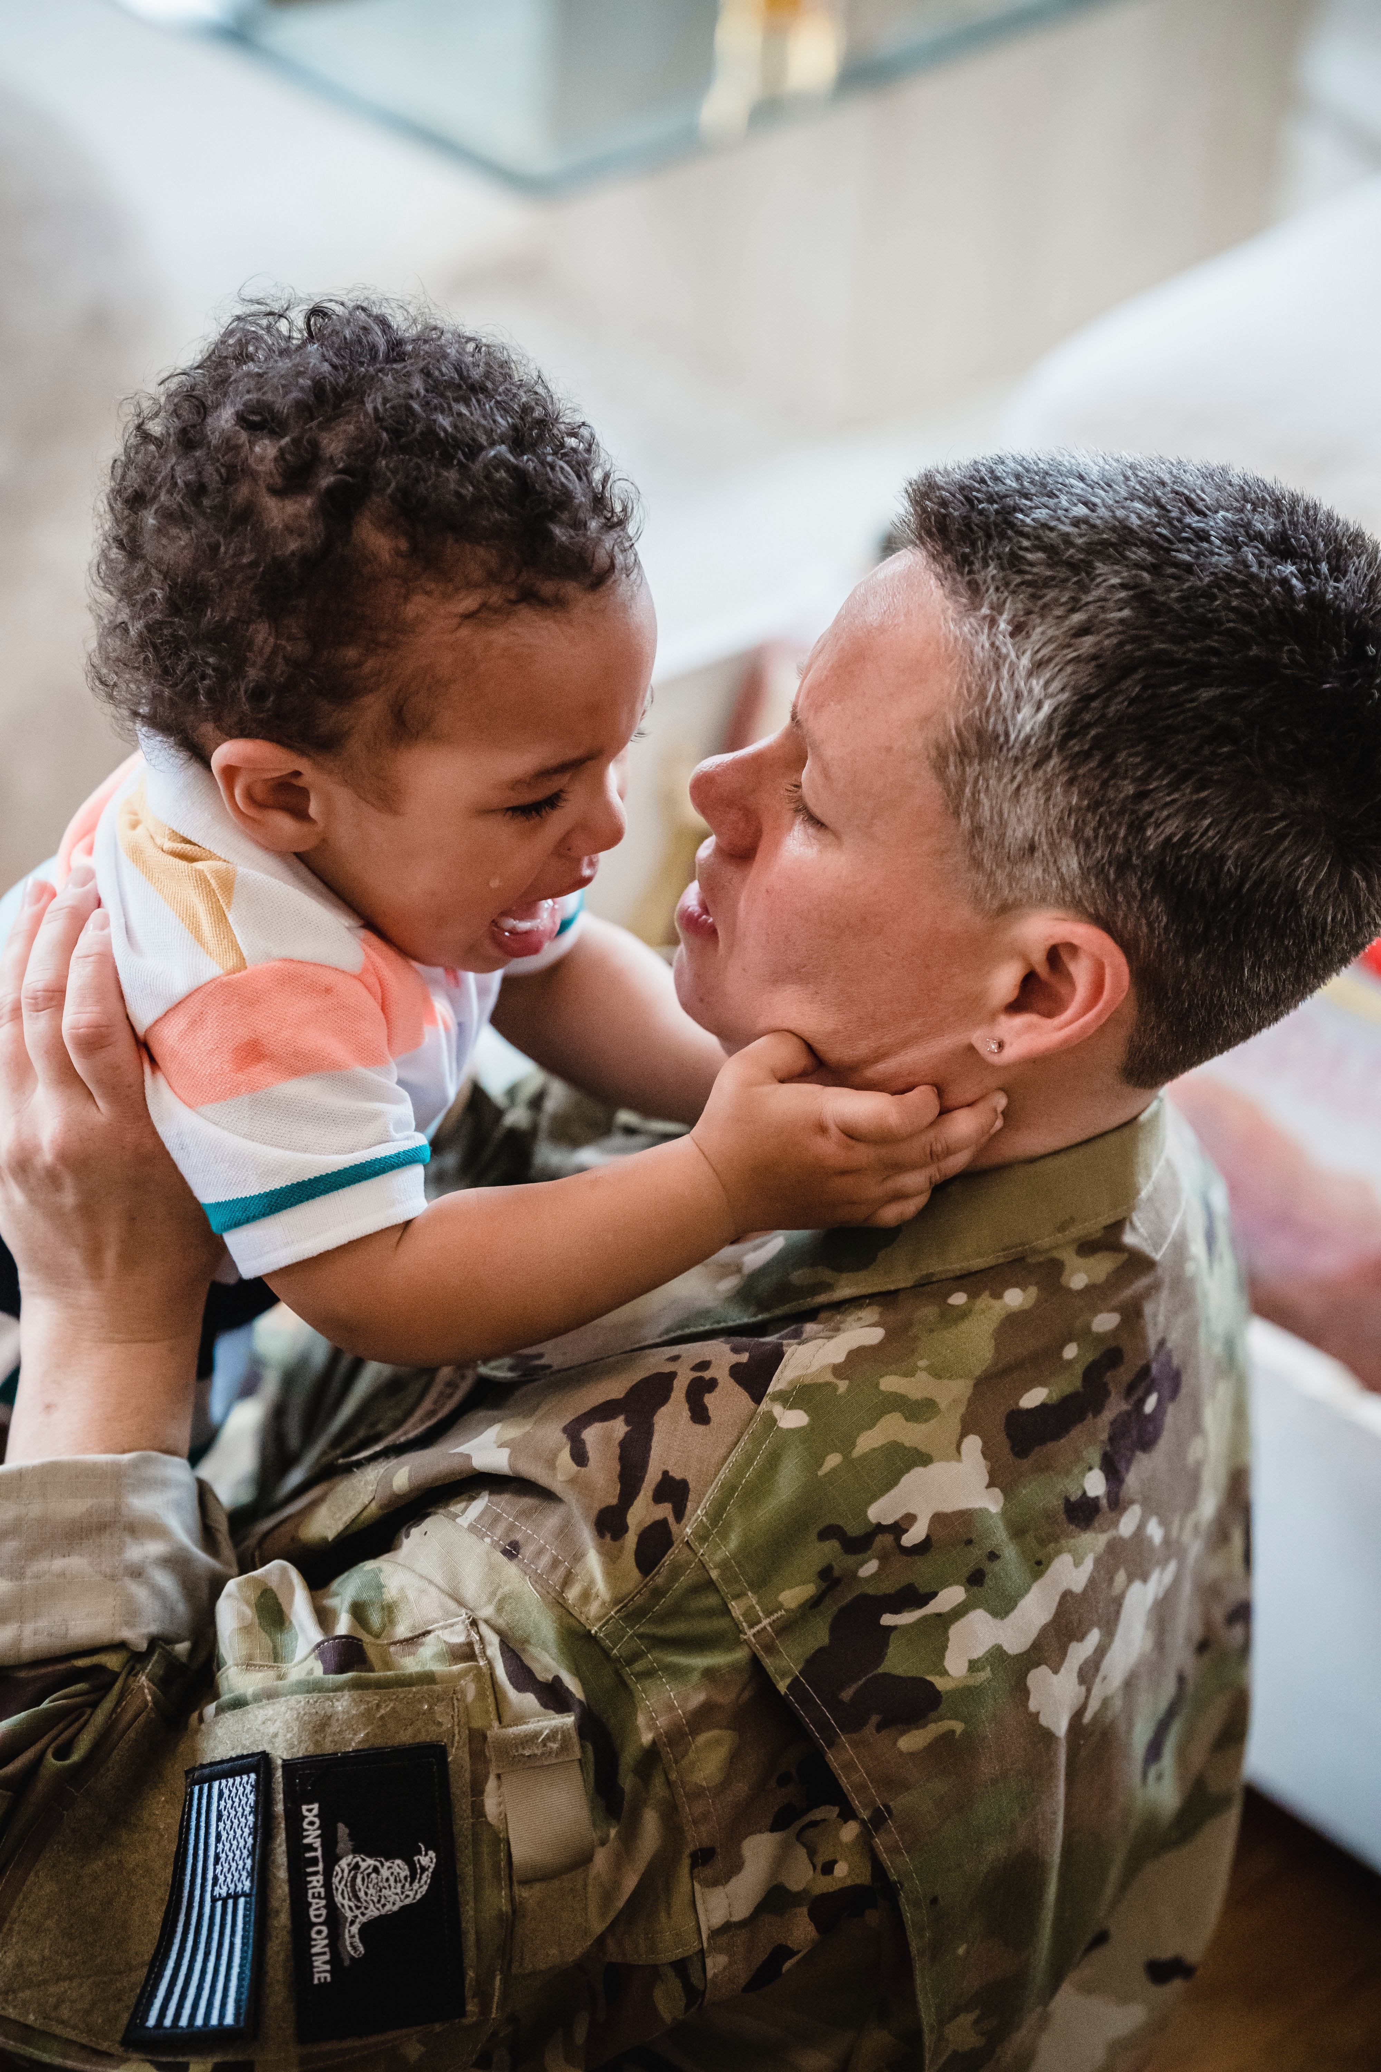
may not always
be as expected...
Notes:
4
Before moving to the next slide, do a poll and how common do they think maternal mental health issues (anxiety/depression) are during the perinatal time.

Slide 5
Expecting and bringing home a baby brings many emotions...
Happy
Joy
Excited
Love
Empowered
Gratitude
Pride
Guilt
Regret
Anxiety
Fear
Conflict
Disappointment
Loneliness

Slide 6
Why do we call it PMADs?
It’s not just postpartum.
It’s not just depression.
It’s a spectrum of illnesses.
Postpartum depression affects up to
1 in 7 women
Postpartum Anxiety and/or Depression affect up to
1 in 5 perinatal women
and up to 1 in 2 (44%) Black Women
Perinatal mood & anxiety disorders are the #1 complication
of pregnancy and childbirth
Maternal depression is #1 predictor of paternal depression; 1 in 10 fathers will experience PMADs
PERINATAL
Conception to baby’s 1st birthday and beyond

Slide 7
Baby Blues Normal transition | Perinatal Mood and Anxiety Disorders
COMMON: 85% | 20-50%
Onset: first 72 hours, resolves within 2-3 weeks Common and temporary Not considered a psychiatric illness | Onset: during pregnancy or first year postpartum. May be gradual and worsens over time
Symptoms: Emotional roller coaster Lack of concentration Sadness/weepiness Anxiety Loneliness Unsettling but do not interfere with ability to function | Symptoms: Mood swings Tearfulness Irritability Anxiety Overwhelmed Affect ability to function
Treatment: Sleep Social support Resolves on its own | Treatment: Varies dependent on illness and severity Consists of some combination of Self-care, Social support, Therapy and/or Medication Will not resolve on its own
Notes:
7

Slide 8
Risk Factors
Notes:
Refer to Predictors & Risk Factors handout
Provide a copy of this handout
Hormonal changes
Sleep deprivation
Single biggest identity transition
Unrealistic expectations
Difficulties in pregnancy or birth
Predisposition for depression or anxiety (prior depression is #1 predictor for PMAD)

Slide 9
Perinatal Circle of Healing

Slide 10
PSVa Resources

Slide 11
Social Support Groups
PSVa offers 60 free virtual support group sessions per month.
We offer specialty groups including:
Healthy Moms/Healthy Babies group for Women of Color
Feeding Support
NICU support
Military Families
Group Schedule

Slide 12
Peer Mentor Program
Provides access to one on one peer support rather than a group setting. Mentees are paired with a mentor with similar background or experience.
Through weekly communication, mentors and mentees build relationships that
removes isolation
provides education and referrals
break down stigma

Slide 13
PSVa Warmline
Warmline: Call 703-829-7152
The Warmline is NOT a Hotline-calls/texts are returned with 12 hours
National Maternal Mental Health Hotline 1-833-943-5746 (1-833-9-HELP4MOMS)
#1 for English, #2 for Spanish
Text in English: 540-698-1277 & Texto en Espanol: 757-550-4234

Slide 14
PSVa: Care Coordination
Care Coordinators will help find necessary resources in your area (therapists, psychiatrists, doula, food pantries, lactation providers, etc)
Call PSVa Warmline 703-829-7152
English or Spanish

Slide 15
Shelane's Fund Grants
Microgrants provided to families to remove financial barriers to access of care 1 page application
Grants have been used to cover: co-pays for therapist, psychiatrist,
postpartum doula, etc
Shelane's Funds are funded by our annual fundraiser Shelane's Run
https://www.shelanesrun.org/

Slide 16
Resources
Directory: https://postpartumva.org/support-directory/
Mental health, psychiatric, and support services
PSVa Fact Sheets (English & Spanish)
Predictors & Risk Factors
Circle of Healing
Postpartum Plan
Birth Trauma
Signs & Symptoms of Anxiety

Slide 17
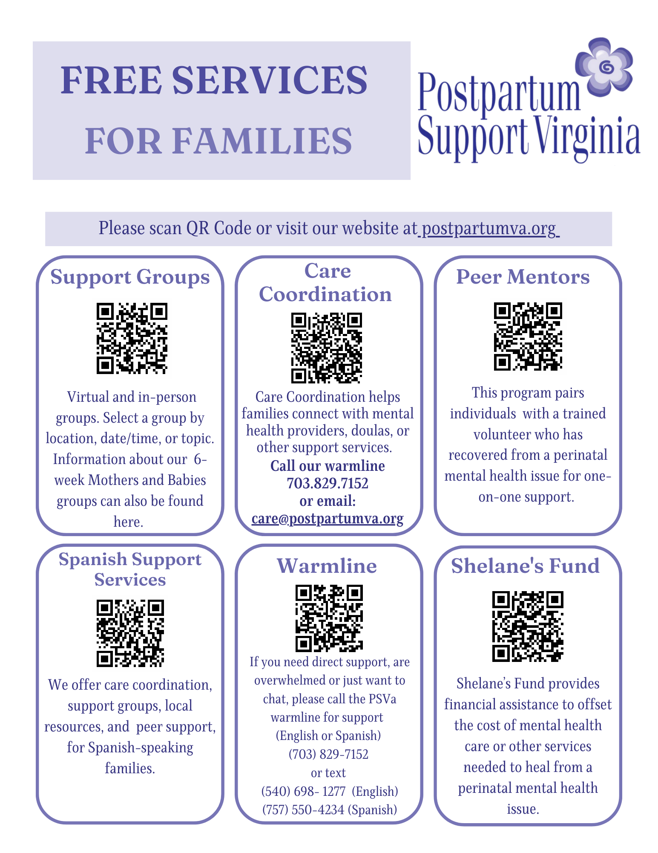
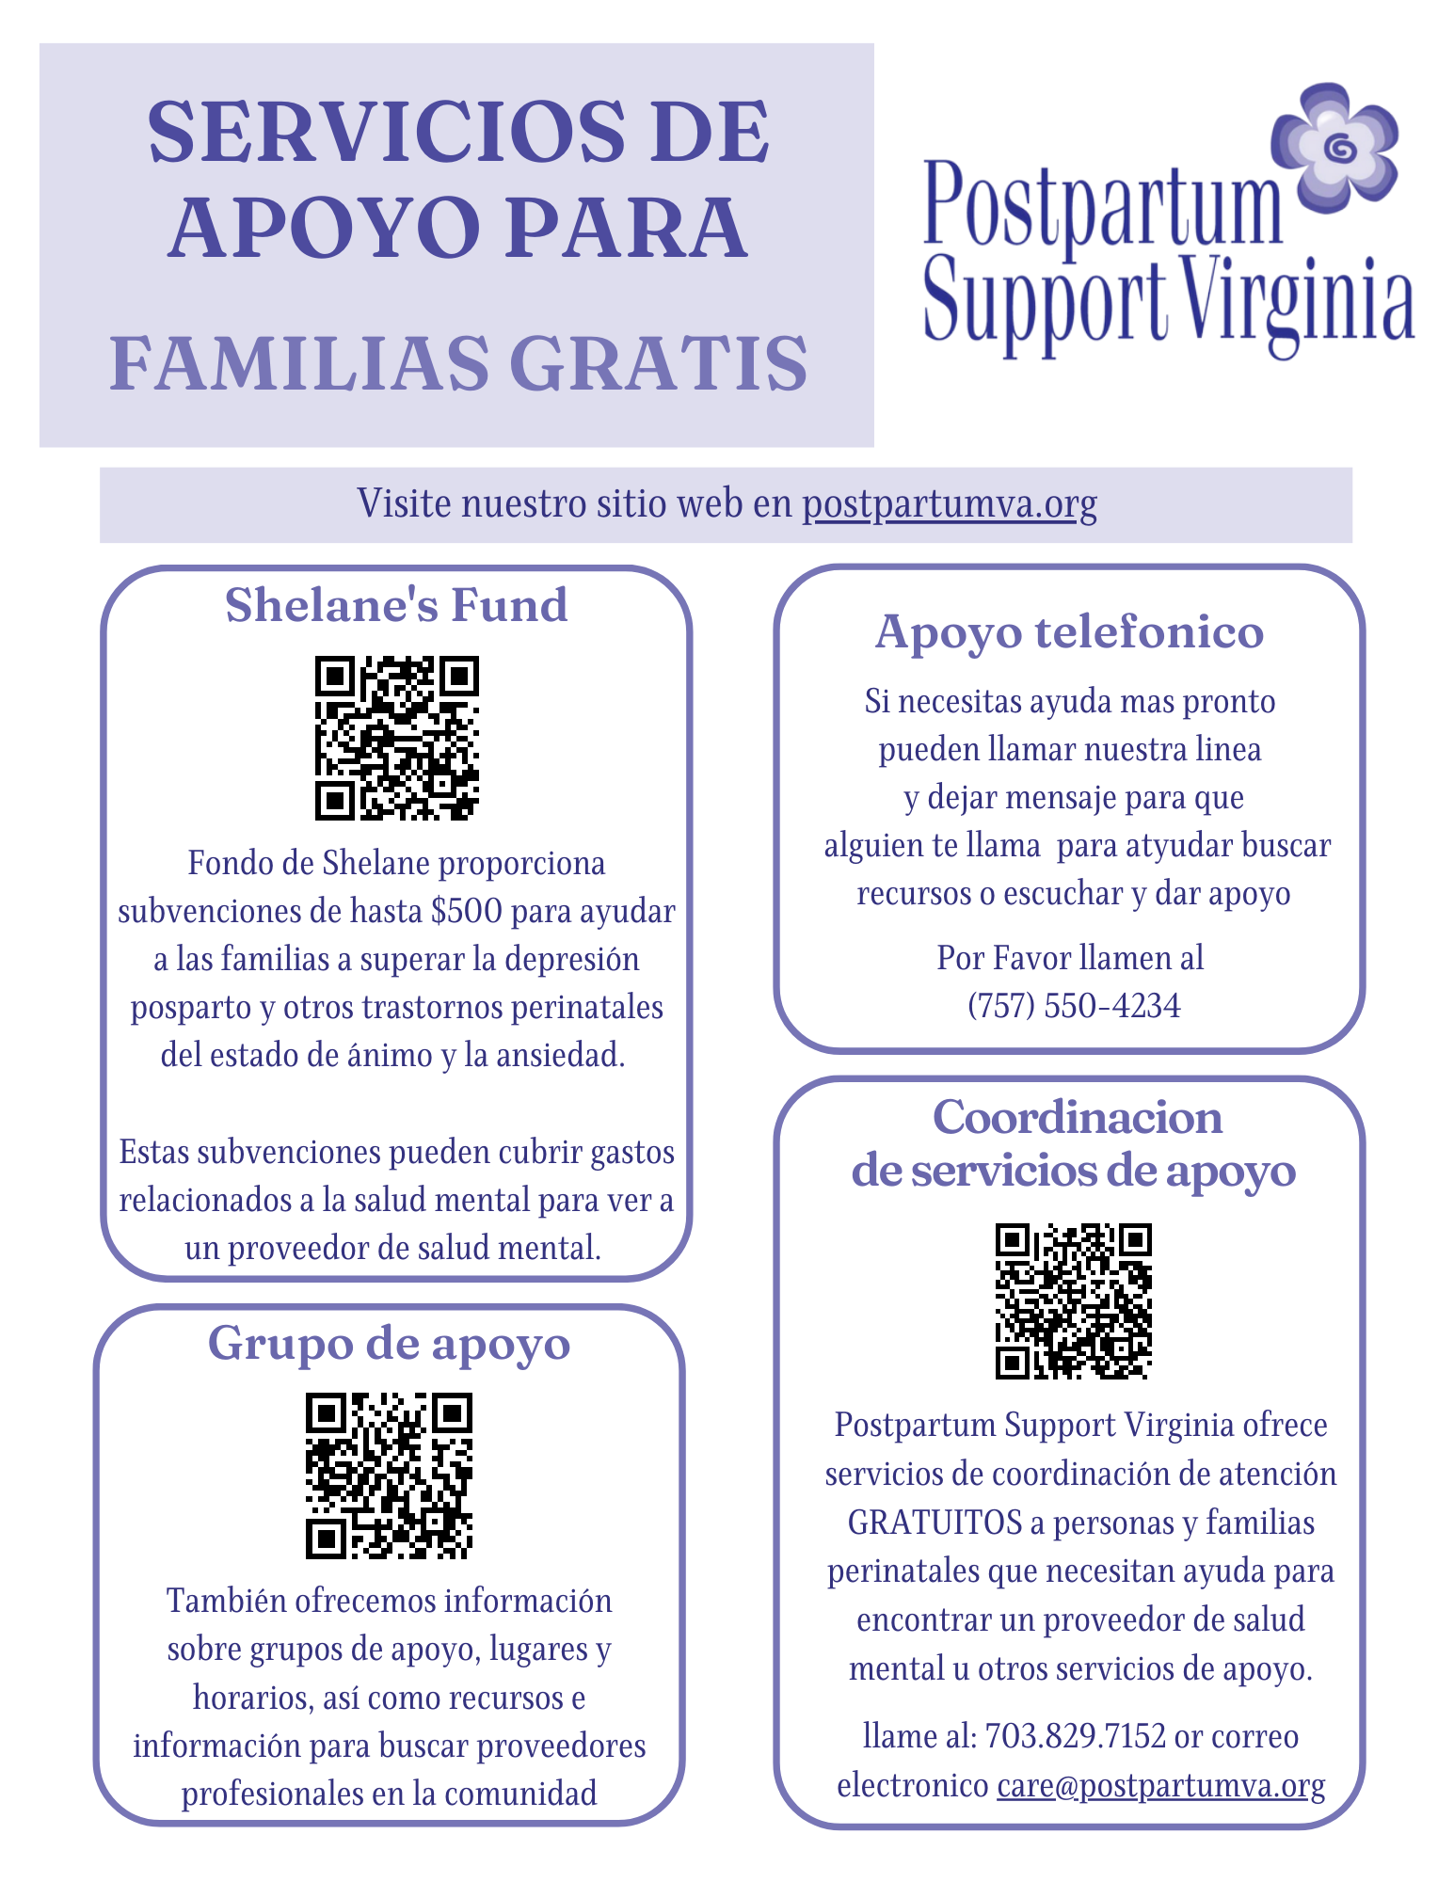
All Services Flyer

Slide 18
Questions or Comments?

Slide 19
Contact Information
Postpartum Support Virginia
www.postpartumva.org
info@postpartumva.org
703-829-7152

