Slide 1


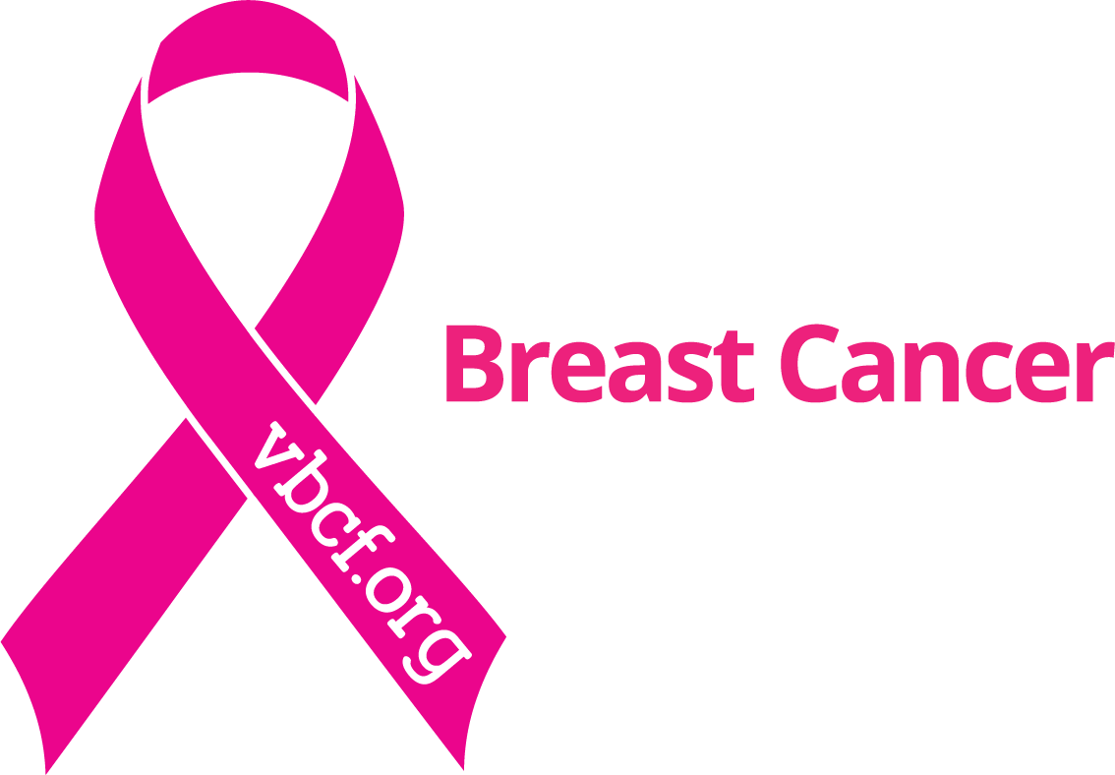
Sponsored by the Virginia Breast Cancer Foundation
Presented by: Erin Steigleder, MSW

Slide 2
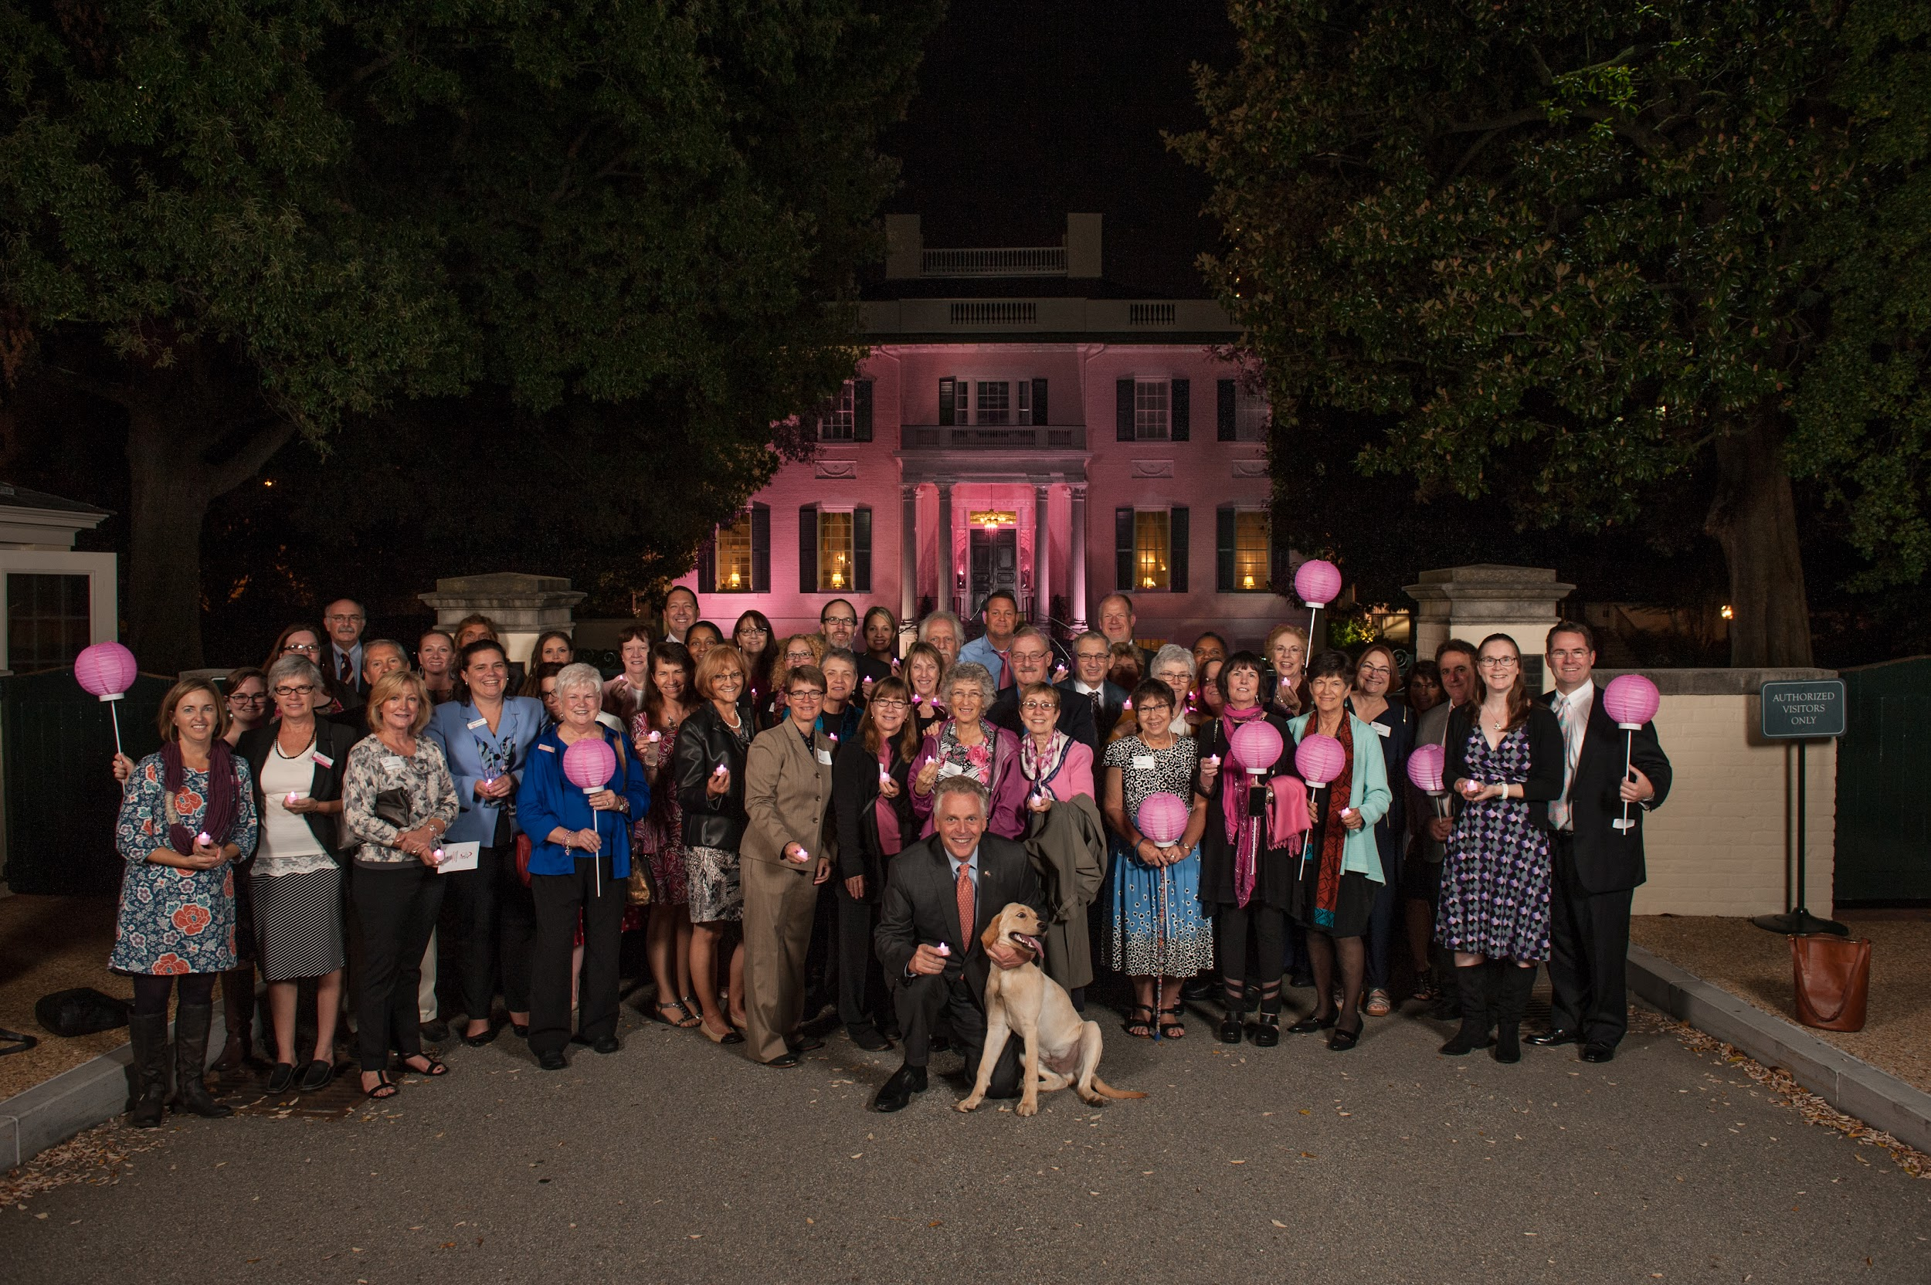
Overview:
About VBCF
Education
Access
Advocacy + Community Action
Notes:
I’ll begin our time today by giving you an introduction to VBCF, then we will go over some information about breast health and breast cancer. After that, we will go into ways that VBCF works to improve the lives of women with breast cancer in Virginia and hopefully to eradicate the disease altogether. I will also let you know ways you can help us in that fight!

Slide 3
VBCF’s Mission
We empower Virginians impacted by breast cancer through access, advocacy, education, and community action.

Slide 4
Founding of VBCF
Notes:
VBCF was founded in 1991 by 5 women who were frustrated by lack of state and local resources available for women with breast cancer. Many of them were receiving the same treatments for breast cancer that their mothers had received decades earlier. Thankfully, the landscape of breast cancer has trained drastically since we were formed 32 years ago, but there is still much work to do. We are home-grown, and Virginia women are our priority. We keep that same fire that our founders had for making sure that people knew the warning signs of breast cancer and for making the system accessible so people can get the help they need, when they need it.

Slide 5
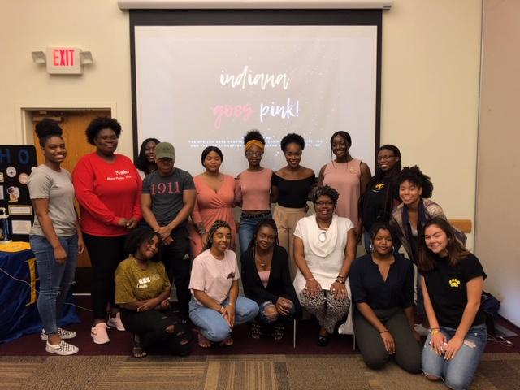
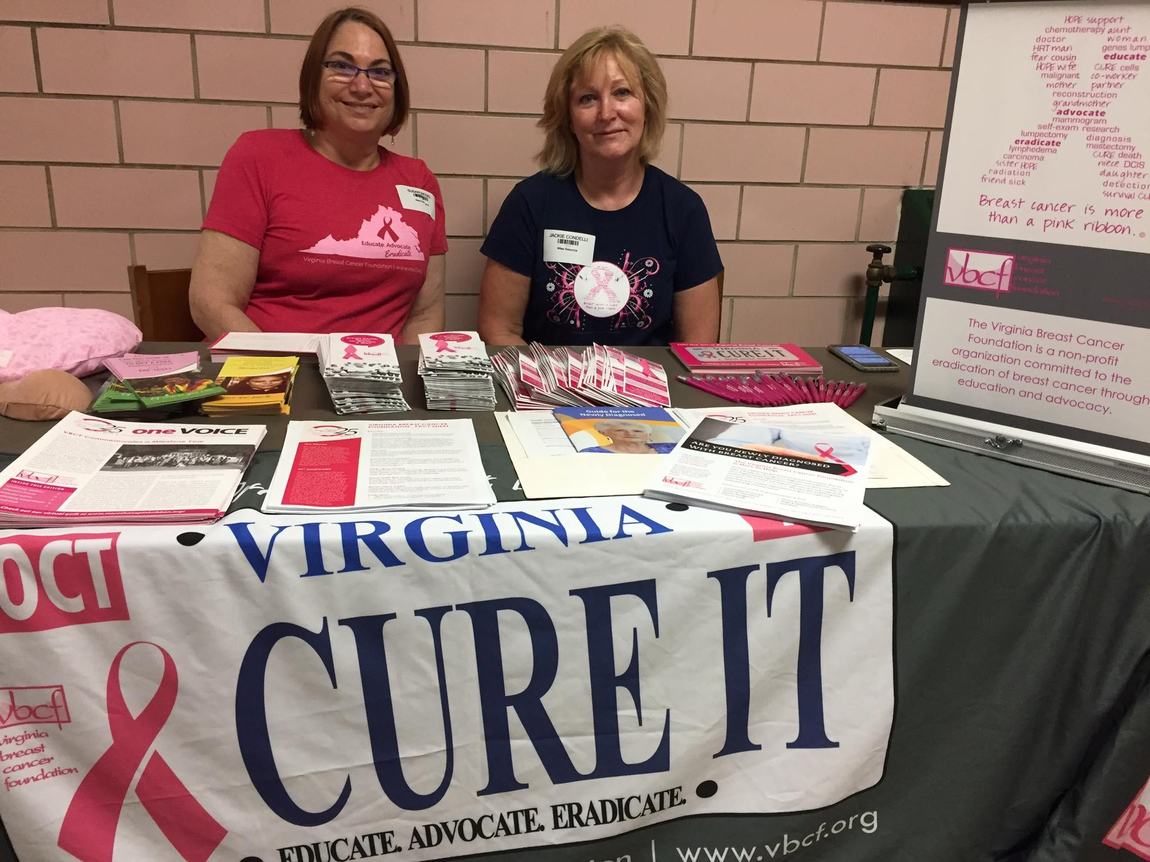
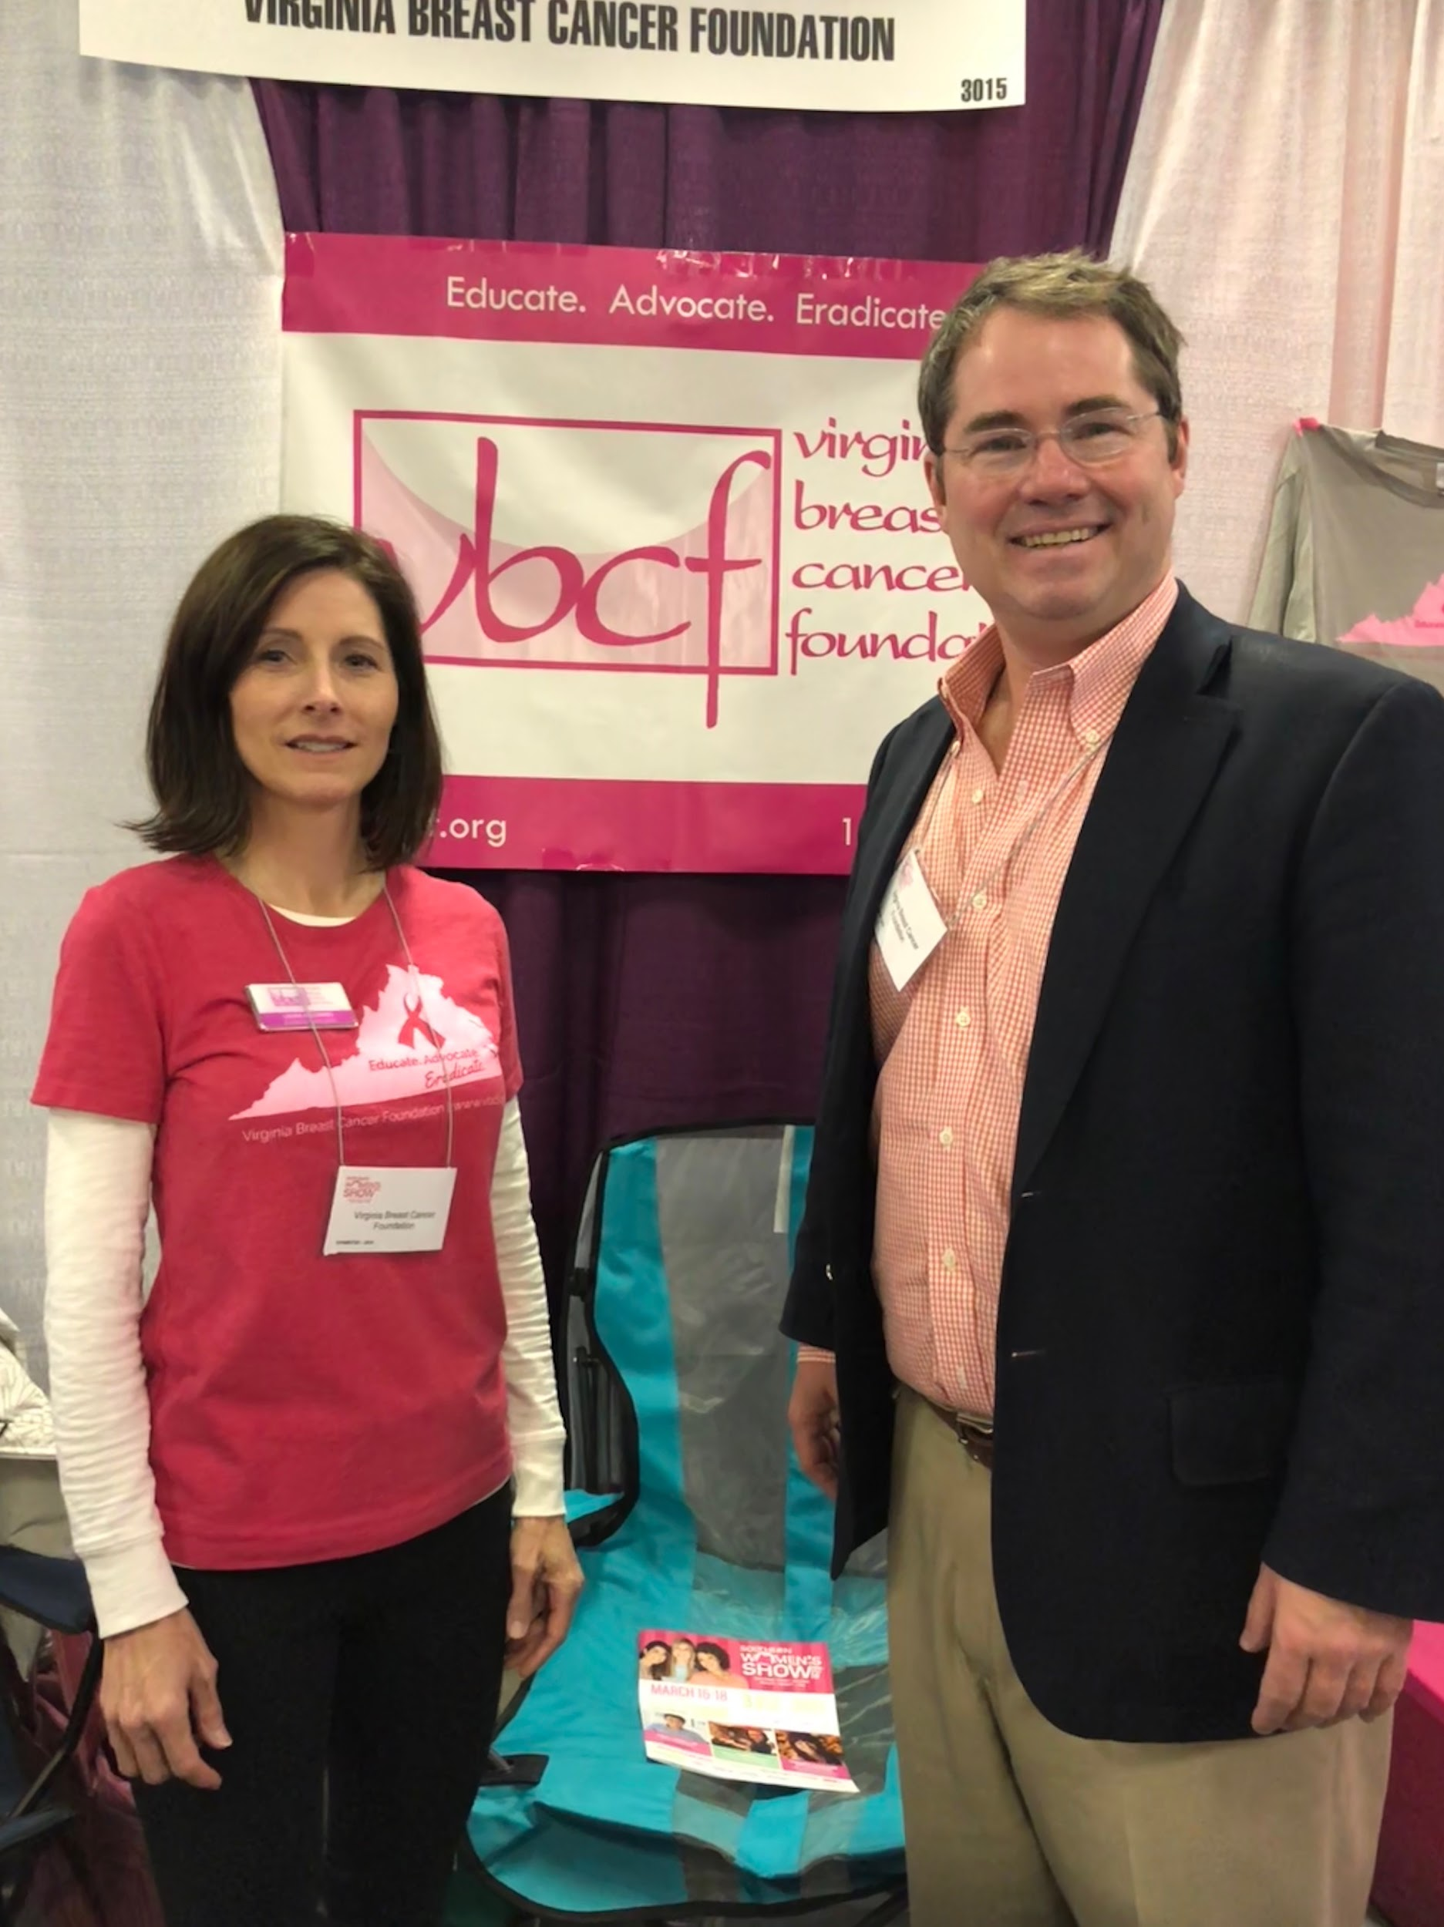
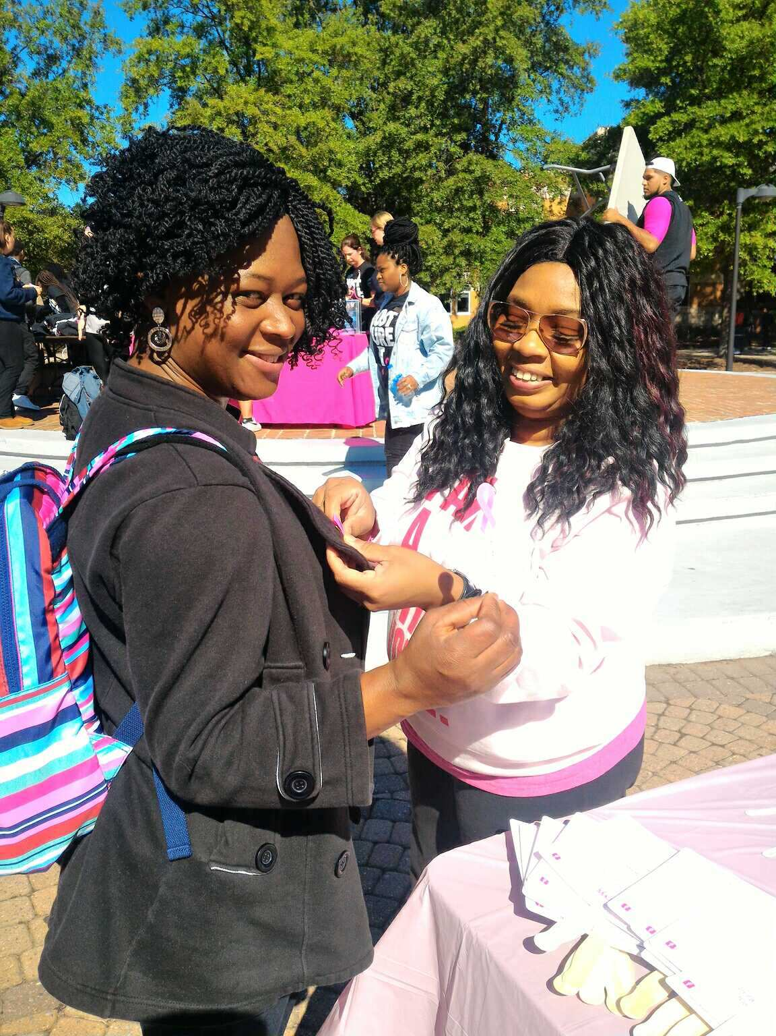
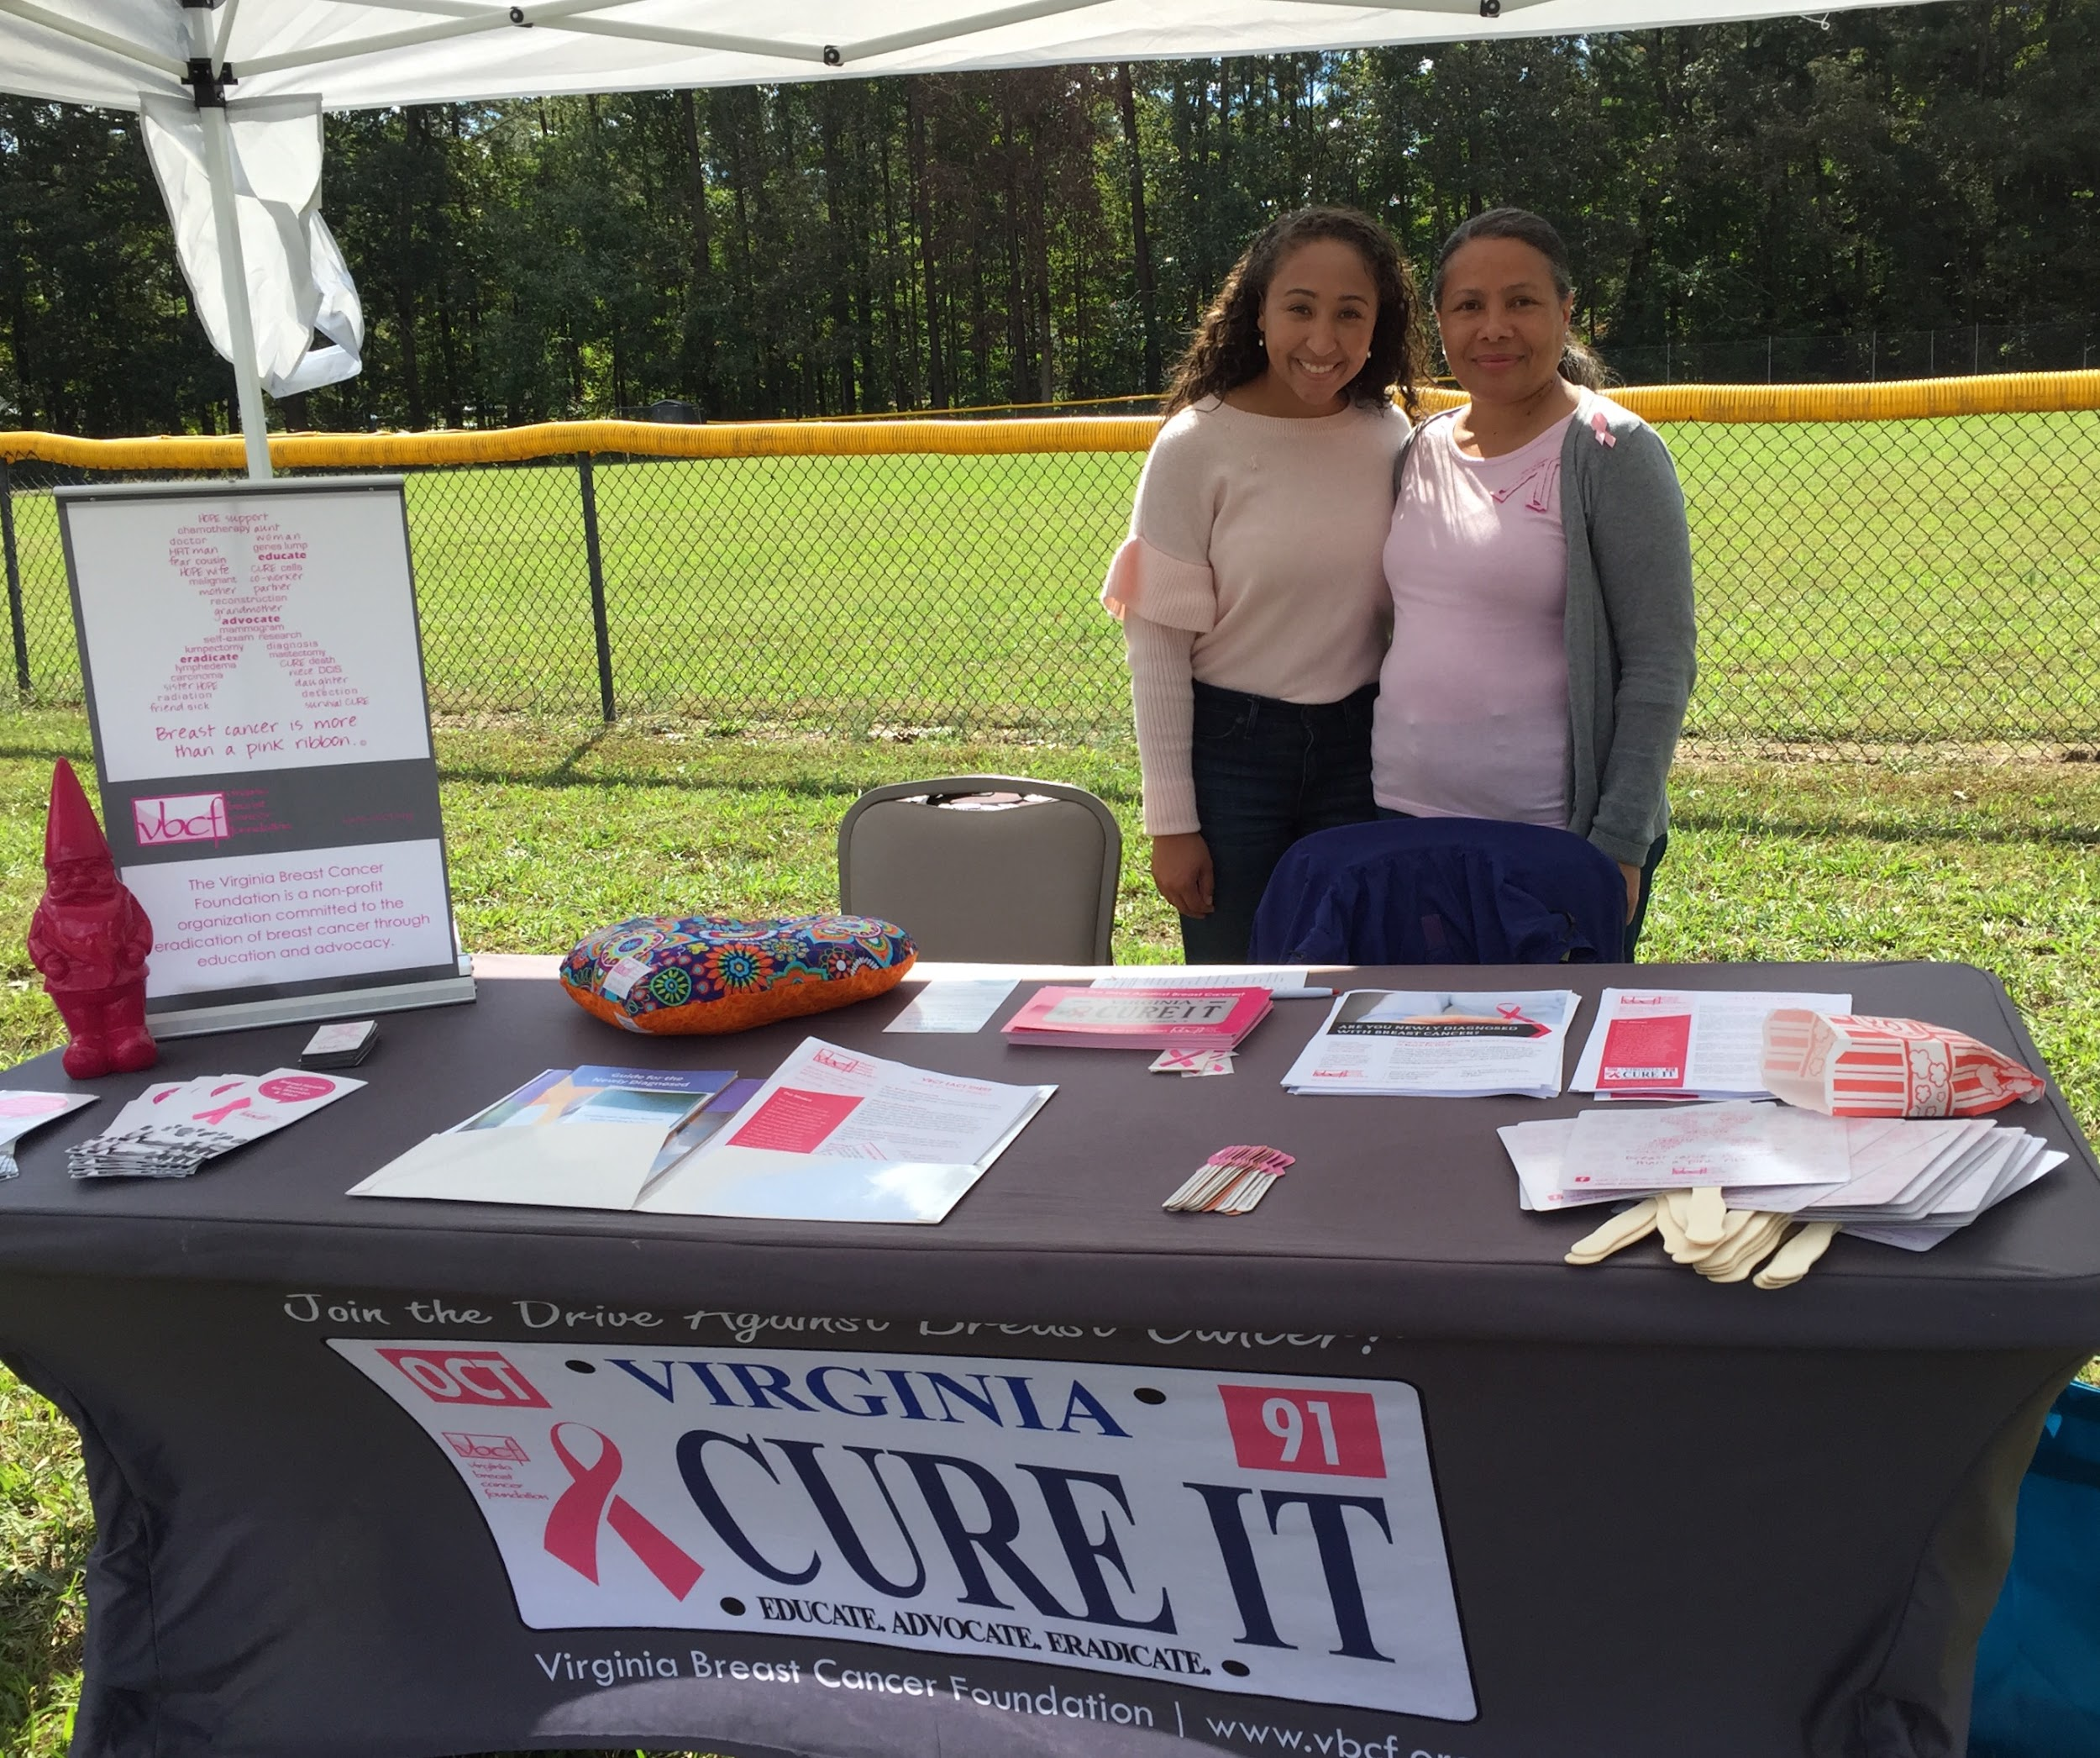
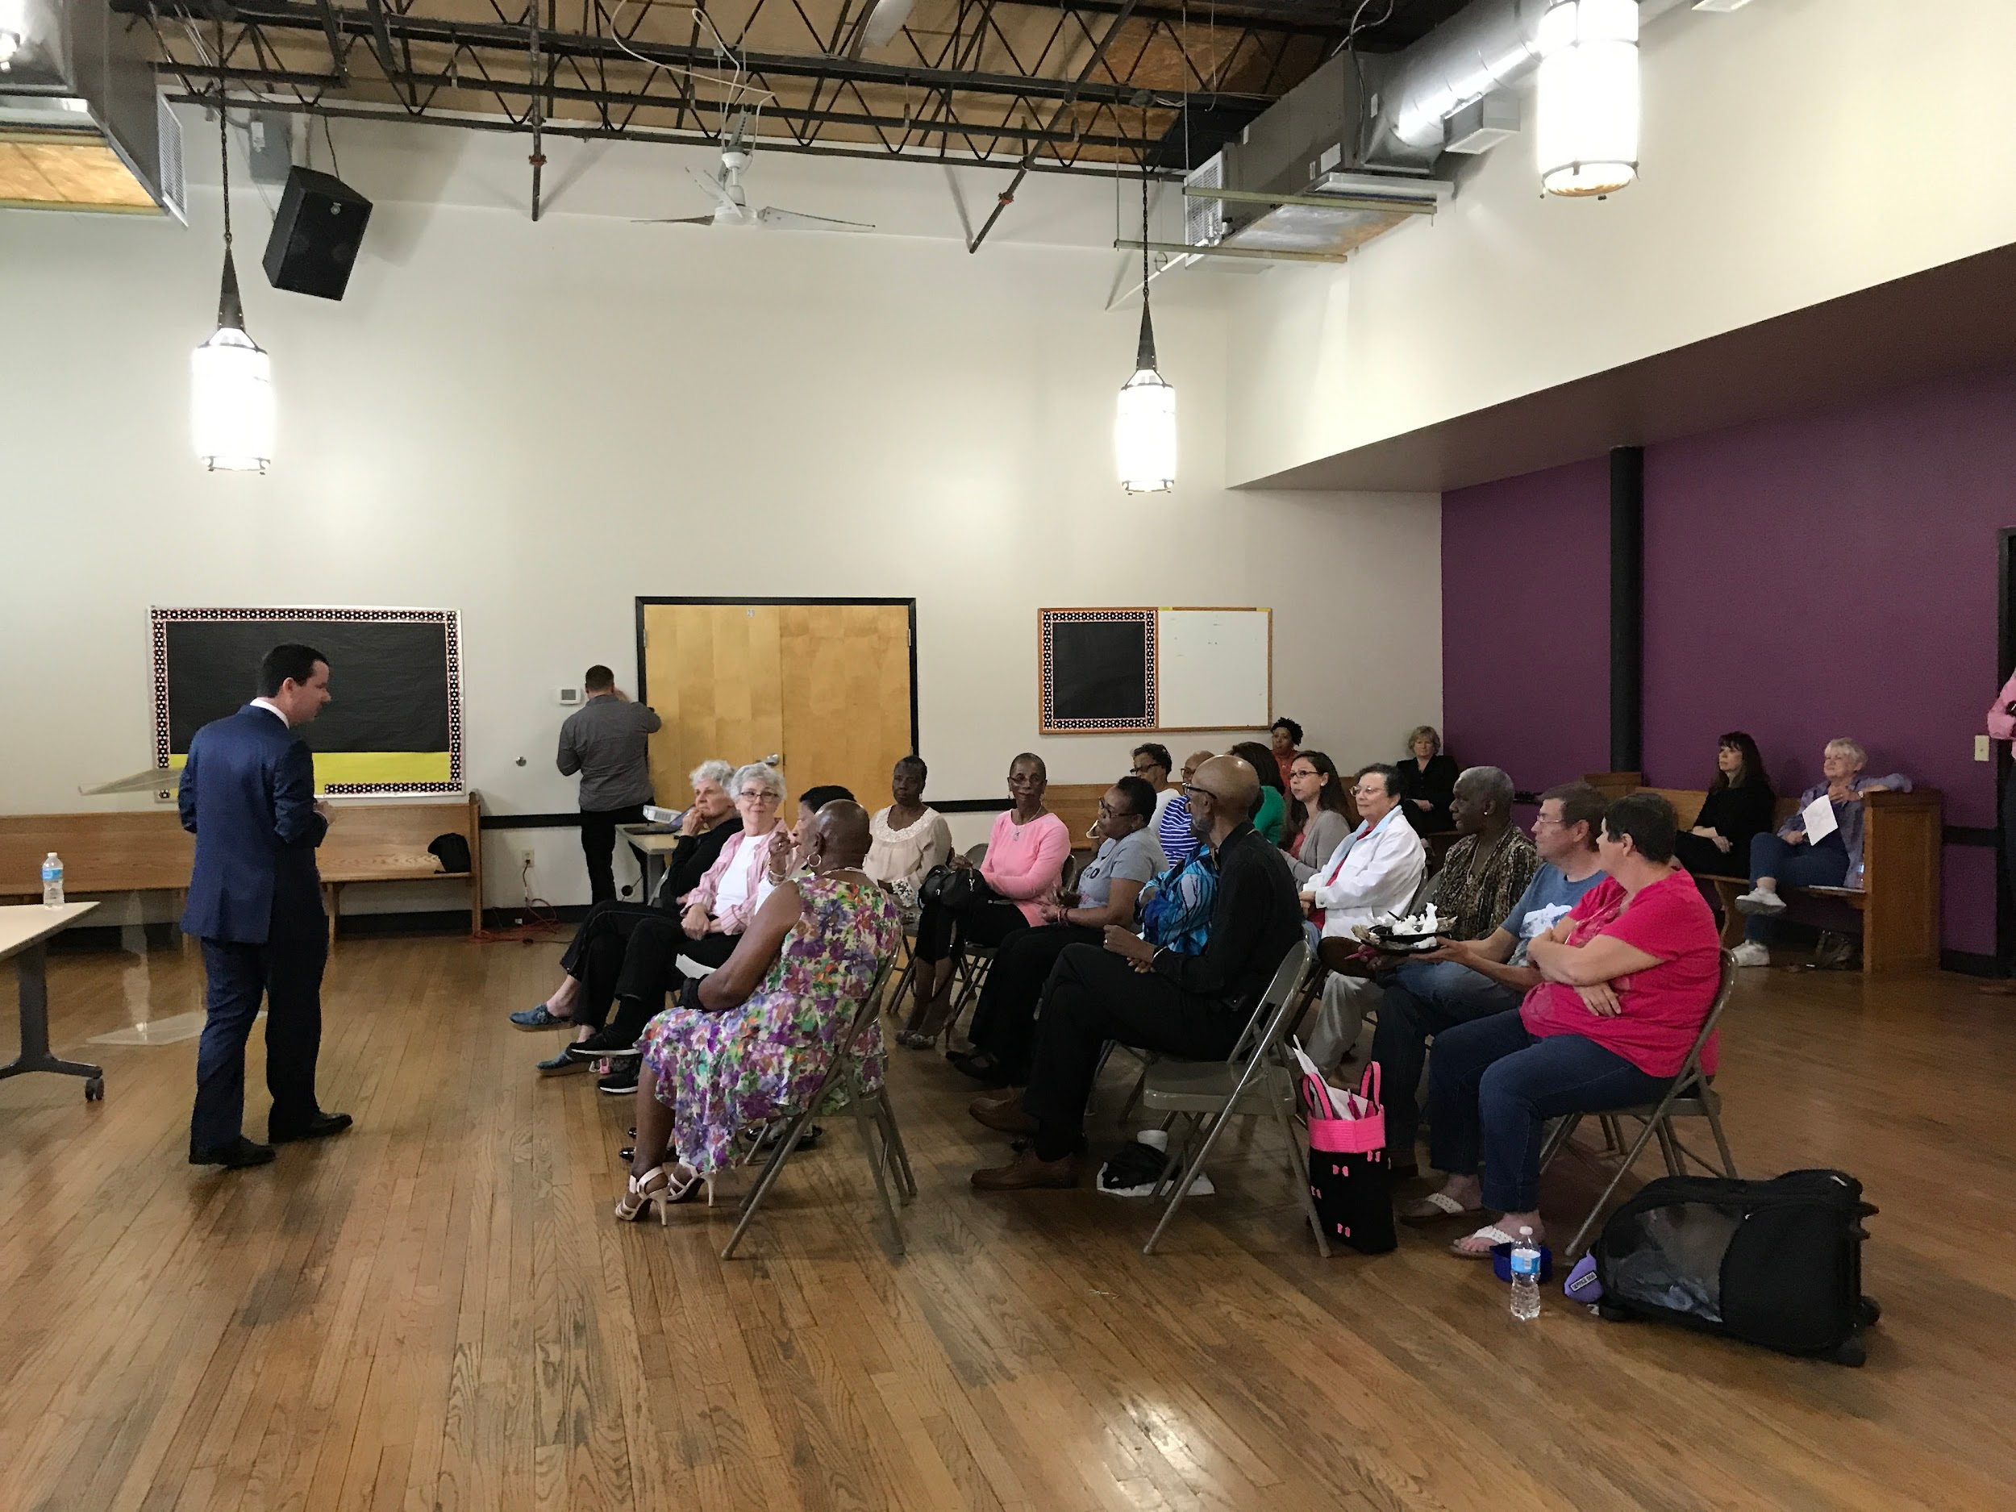
EDUCATION
Notes:
How does VBCF educate?
presentations
RAM (Remote Area Medical)
Library program
newly diagnosed kits
resources on our website
educational events
presentations like this one!

Slide 6
Pop Quiz!:
How many milk ducts do women have in each breast, on average?

Slide 7
Pop Quiz!:
There are between 5 and 8 ducts in the average breast.
Notes:
Ok, so why do you need to know this? You don’t really, but I will tell you that when I learned that, I was surprised. There was something about my body that I didn’t know, and I didn’t know that I didn’t know it. When it comes to breast cancer, and any other illness really, understanding your body and how it normally looks and behaves is essential to early diagnosis. Knowledge really is power. Also, doctors and researchers didn’t know this either until the 1990s, because they didn’t bother to look. We are somewhat behind when it comes to understanding female anatomy, but we are making progress.

Slide 8
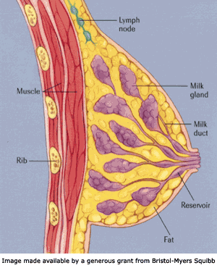
What is Breast Cancer?
Notes:
Definition of breast cancer: Cancer occurs when cells in the body grow, change and multiply out of control. Usually, cancer is named after the body part in which it originated; thus, breast cancer refers to the erratic growth of cells that originate in the breast tissue. I read a great description of how breast cancer develops in Dr. Love’s Breast Book. She talks about how abnormal cell growth is pretty common, but our bodies have their own systems that help keep these cells in check. She provides the metaphor of the “bad neighborhood.” If a bad cell is in a good neighborhood, one in which the surrounding cells are doing what they are supposed to do, the “good” cells can control the abnormal cell and keep it from causing more trouble. But if the abnormal cell is in a cellular neighborhood that isn’t well regulated, that cell is allowed to multiply and spread, causing the cancer.

Slide 9
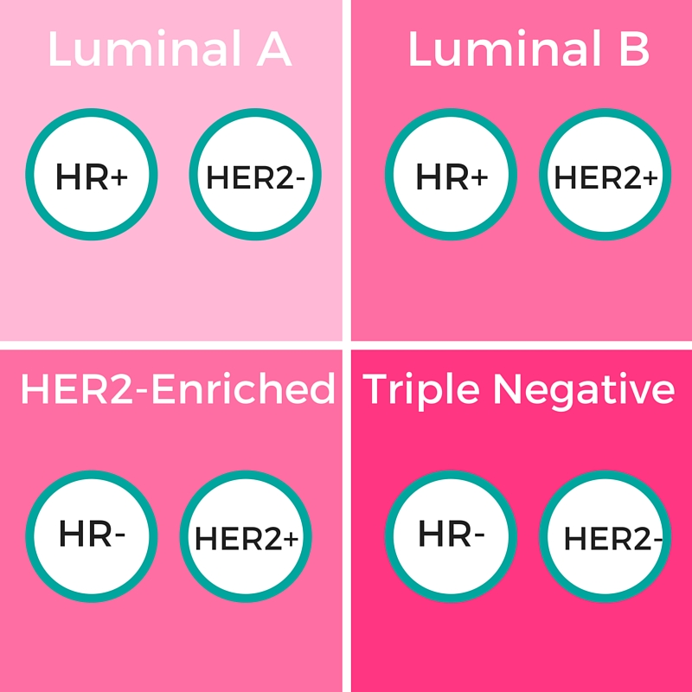
Types of Breast Cancer
Notes:
These are the 4 main types of breast cancer. I know the words and symbols can be intimidating, but what is helpful for you to know is pretty basic. The top two types of breast cancer are hormone sensitive, meaning that they are stimulated by estrogen and/or progesterone, normal female hormones. These cancers can actually be treated in part by taking a pill, and maybe no chemotherapy at all. Luminal A, top left, is the most common type of breast cancer and is associated with the best prognosis because it is slower growing and less aggressive. Luminal B is more aggressive than Luminal A because it has excessive levels of a growth factor receptor, just like the next type, HER2-Enriched. HER2-Enriched is the rarest form of breast cancer and spreads pretty aggressively because of the growth factor receptors, but things are better now because there is a specific treatment that targets the growth receptor and improves the prognosis for people with this cancer type. The last type of breast cancer is triple negative, meaning it doesn’t have the hormonal receptors or the growth factor receptors of the previous cancer types. This type of cancer leads to a poorer prognosis because there are no targeted therapies for it. It is also two times more common in African American women than white women in the US, and more common in women with the BRCA1 gene mutation.

Slide 10

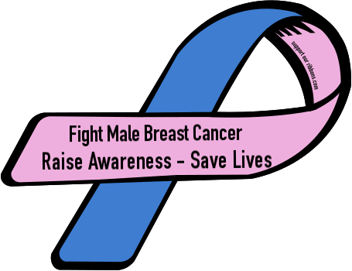
Breast Cancer Statistics 2023
Women: (US)
297,790 new invasive cases
43,170 deaths nationwide
7,810 cases in Virginia; 1,150 deaths
Black women 5 year survival: 83%
White women: 92%
Men: (US)
2,800 new cases
530 deaths
Notes:
Number of diagnoses keeps going up, deaths from breast cancer haven’t risen very much

Slide 11
Pop Quiz!:
Getting a mammogram every year can reduce a woman’s chance of getting breast cancer.
True or False?

Slide 12
Pop Quiz!:
FALSE.
Mammograms do not prevent breast cancer, they only help detect it.

Slide 13
How Breast Cancer Is Usually Detected
Self and/or Partner Detection–We ALL have a role to play
Clinical Breast Exam
Mammography
Breast Ultrasound *
Breast MRI *
Notes:
Know YOUR body. A good time to do this is while you are in the shower or getting dressed. Or, your partner may discover a lump or a change in your breasts.
It is important to know what is “normal” for you.
For certain women at high risk for breast cancer based on the previously outlined criteria, a screening MRI is recommended along with a yearly mammogram.
Breast MRI and ultrasound are not usually used in place of mammography for screening, but as additional tests.
Ultrasound is used to complement other screening tests.
MRI is used in screening high-risk women; to gather more information on an area of suspicion; and to monitor for recurrence after treatment
If you are at a higher risk, talk to your doctor about what screening tools are right for you and when to begin regular screenings

Slide 14
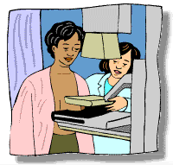
Mammogram
A mammogram is a low-dose X-ray that can find cancers before they can be felt.
Q: When should you get a mammogram?
A: Whenever you and your doctor decide!
Notes:
MAMMOGRAM is a low dose x-ray that can find cancers before they can be felt.
A mammogram may feel uncomfortable, but only for a few minutes. If you are going to a new imaging center or new radiology center for your mammogram be sure to bring your previous mammograms with you.
A. If you have a significant family history or multiple risk factors, your doctor may recommend mammograms at an earlier age. If you have a family history, it is recommended to get your first mammogram at 10 years before the age of diagnosis for a 1st degree relative.
B. Be sure to notify the mammography staff if you or your doctor have noticed a change in your breast. Mammograms are not 100% accurate. Even if you are told that your mammogram is normal and you have noticed a change, follow-up with your doctor.
C. Mammography is the best tool we have today. Other detection methods that your doctor may recommend include ultrasound, MRI or digital mammography. You may want to discuss these options with your doctor.
D. 20% of Virginian women age 45 and older have not had a mammogram in the last 2 years. This number has decreased from 30.6% in 1990 but still needs to decrease more!
(2012 statistic)

Slide 15
Benefits of Early Detection
May have more treatment options
Improved survival rate
5 year survival rate
  98% if it has not spread
  23% if it has spread to other parts of body
Notes:
Mammography reduces the risk of dying from breast cancer by 20%
You may have more treatment options due to early detection, such as a lumpectomy vs. mastectomy, no chemotherapy, hormonal therapy, etc.
A note about the survival rate, this percentage is the women who are alive 5 years later, that does not mean they are cancer free. Some of them may be dealing with a recurrence, some may have metastatic.

Slide 16
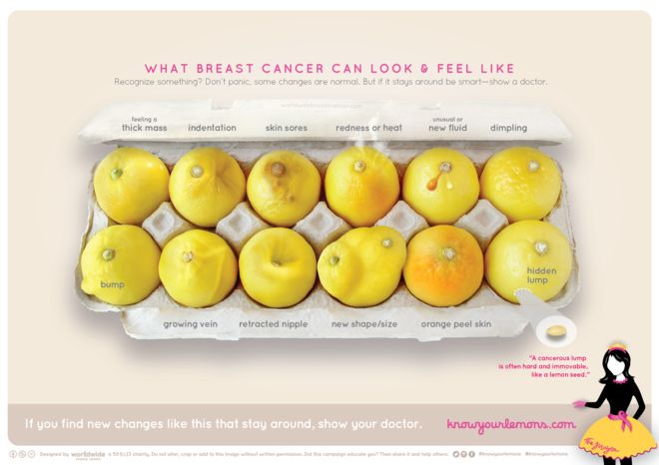
What am I Looking For?
Notes:
A lump or thickening in your breast or under your arm.
Nipple changes: Inverted, crusty, spontaneous bloody discharge, point in different direction.
Dimpling, indentation or orange peel appearance.
Change in breast size, shape or skin color.
A wound, sore spot or break in skin that does not heal.
Change or difference from one breast to the other.
If you notice a change, have it checked by your doctor. Lobes & ducts may become enlarged before each menstrual cycle & during pregnancy in younger women, which is normal, so know your cycle and how your body typically behaves. Most breast tissue is somewhat lumpy or nodular. You just need to know what lumps are usually there and if there is anything new. Also, breast tissue isn’t confined to just your breast. Pretty much everywhere a sports bra touches (except your back) is breast tissue. Trust your intuition. Don’t be embarrassed. Be your own advocate.

Slide 17
Pop Quiz!:
You don’t have to worry about breast cancer if there isn’t any on
your mom’s side.
True or False?

Slide 18
Pop Quiz!:
FALSE.
Father’s family history matters as much as mother’s.
85% of people diagnosed with breast cancer don’t have a family history.

Slide 19

What are the Risk Factors for breast cancer?
#1 Risk Factor – Being born biologically female!
Notes:
Research is not yet clear on the breast cancer risk for people who are transgender, but that is definitely a topic of current research and I am sure we will learn so much in the next decade.

Slide 20
Risk Factor: Age
Chances that a woman will develop
breast cancer in the next 10 years of her life*
1 in 8
1 in 14
1 in 26
1 in 24
1 in 209
At Age At Age At Age At Age
39 59 69 70 & Older
From Birth to Death
Notes:
This chart illustrates that as women get older, the chance of developing breast cancer increases. This is why it is suggested that women start getting mammograms around *here*, right before the risk of developing breast cancer skyrockets. And this is why those mammograms are so important. Leading cause of cancer death for women between 20-59.
Age to stop mammograms? Until recently, there was a belief that the benefits of mammography did not outweigh the risks of a false positive after a woman reaches 75. A recent study of 7 million mammograms shows that might not be true. The risk of false positive actually decreases with age, so women should continue to get them after 75, especially if they are generally healthy. For example, my grandmother is 95 and has dementia, she should no longer be getting mammograms. My other grandmother is 84 and generally in good health (in addition to being a breast cancer survivor). She should still be getting mammograms.

Slide 21
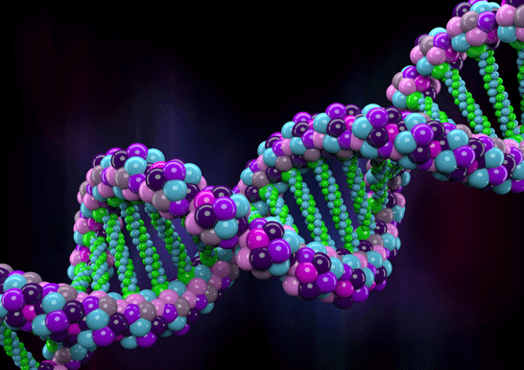
Risk Factor: Genetics
Notes:
Over the past few years, there has been great advancement in breast cancer research, particularly in the field of genetics. There are genetic mutations that people can be tested for to better understand their risk of breast cancer, with the most common and commonly heard about being BRCA 1 and BRCA 2. Undergoing genetic testing is a very important decision and should be considered carefully because the results will not only affect the individual being tested, but that person’s whole family as well. If you have a direct relative who has had breast cancer, or even an extensive history of various cancers in your family, you may be eligible to receive no-cost genetic counseling and testing for the BRCA1 and BRCA2 mutations through your insurance, thanks to the Affordable Care Act. If you or a family member have had genetic testing or counseling before, it may be worth going back every 5-10 years to a counselor because the field is advancing so quickly. Your genes won’t have changed, but science’s ability to read those genes and interpret the meaning of possible mutations is now constantly changing.

Slide 22
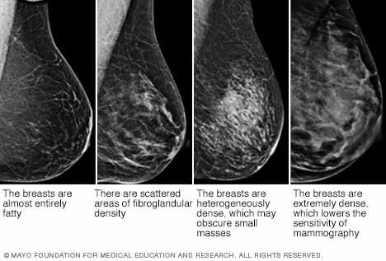
Risk Factor: Dense Breasts
50% of tissue shows “white” on mammogram
  Harder to spot cancerous tissue
Increases risk of cancer
3D mammography (tomosynthesis)
Notes:
-3D mammograms have a 40% decrease in callbacks and an increase in the detection of invasive cancer compared to 2D mammograms
-3D mammograms covered by Tricare under provisional coverage until 2024

Slide 23

Differences Between Groups
Racial/ethnic differences
Sexual and Gender Minorities
Notes:
For a long time, White women had the highest chance of developing breast cancer, now diagnosis of African American women has risen to the same rate as White women. This rise of AfAm women being diagnosed has been particularly apparent in the South
African Americans: African American women are often diagnosed younger and at a more advanced stage of cancer than White women. We now know that African Americans also are more likely to get a more aggressive form of breast cancer called Triple Negative Breast Cancer for which there is no targeted therapy, but does seem to respond well to chemotherapy. AfAms are 41% more likely to die from breast cancer than White women. They are also more likely to experience a delay between consultation and diagnosis, and diagnosis and treatment, though why is not entirely clear. Black cancer survivors may be more likely than whites to wind up in debt or forego treatment due to cost. African-American women were more likely than white women to experience delay in care between initial consultation and diagnosis, as well as between diagnosis and treatment. Most of these differences don’t have anything to do with the physical state of being black, but the how society affects people who are black in the US. AfAm girls also tend to begin menstruation earlier than white girls. In Virginia, African American women and White women get their mammograms at the same rate, yet African American women are still more likely to die.
Asian Americans: In the past there has been the idea that Asian American women are at lower risk for breast cancer, but “Asian Americans who immigrated to the US at least 10 years ago, the risk of BC is 80% higher than that of new immigrants. Those born in US, risk is similar to Caucasian women. “ (from National Asian Women’s Health Organization)
Hispanic women: Breast cancer is the most commonly diagnosed cancer among Hispanic/Latina women. Though they are diagnosed 40% less often than non-Hispanic women, their cancer is frequently found at a later stage and is more aggressive and invasive. Leading cause of cancer death in Hispanic women. Though cancer incidence and death rate due to cancer among Hispanics is lower than non-Hispanics, evidence shows that among Hispanics who migrate to U.S., subsequent generations have cancer rates similar to non-Hispanics. (from American Cancer Society)
In fact, in the last 30 years the gap in mortality from breast cancer between racial groups has widened.
There has not been a lot of research on breast cancer in transgender people, but people from the Sexual and Gender Minority community have historically, and continue to, have difficulty when interacting with the medical community. This can affect consistency of treatment, emotional well being of patients, and even if the person seeks medical care in the first place. For people who are transgender, for example, there are questions as basic as whether they should receive regular mammograms and the emotional implications of that decision.

Slide 24
MORE RISK FACTORS
Menstrual factors
Hormonal birth control
Other health factors – alcohol use, obesity, previous radiation treatment
Notes:
4. Starting periods (menarche) before 11, menopause after 55, having endometriosis
6. A biopsy may confirm abnormal cells. Anytime you have a breast biopsy, always review the results with your doctor. If you have an abnormal biopsy, you may need to be more closely monitored. False positives, while not cancerous at the time of initial testing, may indicate an increased risk for future breast cancer
7. Other health factors – Alcohol consumption and obesity have been linked to a higher risk of breast cancer. Also radiation therapy to the chest wall before age 30 (for treatments such as lymphoma). According to the American Cancer Society, just 1 alcoholic drink a day can raise estrogen levels which may lead to a higher risk, and obesity after menopause puts women at a higher risk because of the increased estrogen levels that come with obesity. Limited physical activity may also be a risk factor. According to www.breastcancer.org, research has shown that 4 hours of exercise a week may lower the risk of breast cancer.

Slide 25
These things DO NOT cause breast cancer...
Deodorant/anti-perspirant
Wearing/not wearing a bra
Underwire bras
Binding breasts
Abortions
Having larger breasts
Caffeine
Living near power lines
Tattoos on/near chest
Cell phones

Slide 26
Reduce Your Risk
There is no way to PREVENT breast cancer, but these things could help:
Exercise regularly
Maintain a healthy waist/hip ratio (better measure than BMI)
  Effect varies by ethnicity/race, where your body “collects” fat
  More important post-menopause
Eat plenty of fruits, vegetables and foods with fiber
Don’t smoke
Limit alcohol intake to no more than 3 drinks /week
Breastfeeding
Avoid exposure to pesticides & chemicals
Notes:
Exercise: It’s not just the weight; it’s the fat and the physical activity.
Get a good night’s sleep. Some experimental studies have shown that melatonin can inhibit tumor growth, and people with frequently disrupted sleep, like night shift workers and flight attendants, have a higher incidence of breast cancer

Slide 27
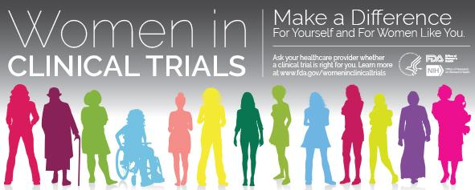
Clinical Trials
Virginia one of the few states to be home to TWO NCI-designated cancer centers, the cream of the crop
Afraid of placebo? Don’t be.
Insurance will (likely) pay for it.
Notes:
76% of cancer patients surveyed in the Cancer Experience Registry were afraid to get a placebo in a clinical trial. In most trials for cancer patients, the control group is given the current standard of care while the experimental group is given the current standard plus the new treatment, or switching out one part of current standard for the new treatment. No placebo is given. Regardless of how the study is going to be conducted, you will be informed. The experimenters are required to obtain your informed consent (a formalized process) before you are admitted into the study.
77% of cancer patients surveyed in the Cancer Experience Registry believed that their insurance company would not pay for treatment in a clinical trial. Virginia requires insurance companies to cover costs of routine care for clinical trials, and so does Medicare.

Slide 28
Pop Quiz!:
If someone gets breast cancer, they did something to cause it.

Slide 29
Pop Quiz!:
FALSE.
Notes:
No one deserves breast cancer. No amount of positive attitude cures breast cancer. There is only a little bit of control we actually have over the risk factors, and we should do what we can, but also it does us no good to dwell in the “what ifs”. Cancer is almost always an interaction between our genes, our environment, and our behavior. It’s a combination of personal responsibility and the systems in which we live.

Slide 30
“Grant me the serenity to accept the things I cannot change, the courage to change the things I can, and the wisdom to know the difference.”
Reinhold Niebuhr
“If I am not for myself, who will be for me? But if I am only for myself, what am I? And if not now, when?” Hillel the Elder
“I’m no longer accepting the things I cannot change. I am changing the things I can no longer accept.” Angela Davis

Slide 31
Access

Slide 32
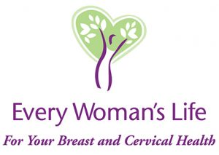
Having a mammogram is uncomfortable,
BUT having one too late can really hurt.
Every Woman’s Life Program
1-866-EWL-4YOU (1-866-395-4968)
Notes:
Free Mammogram/Pap Smear: Available for low-income, uninsured women through the Virginia Department of Health’s Every Woman’s Life Program. Women can call 1-866-EWL-4YOU to see if they qualify. Program may also cover treatment if diagnosed with breast or cervical cancer.

Slide 33
Diagnostic Testing
Mammograms are free, follow-up tests are not
Southwest Diagnostic Fund
Richmond Diagnostic Fund–Coming Soon!
Diagnostic funds are a Band-Aid, we are working to solve the problem through policy change

Slide 34


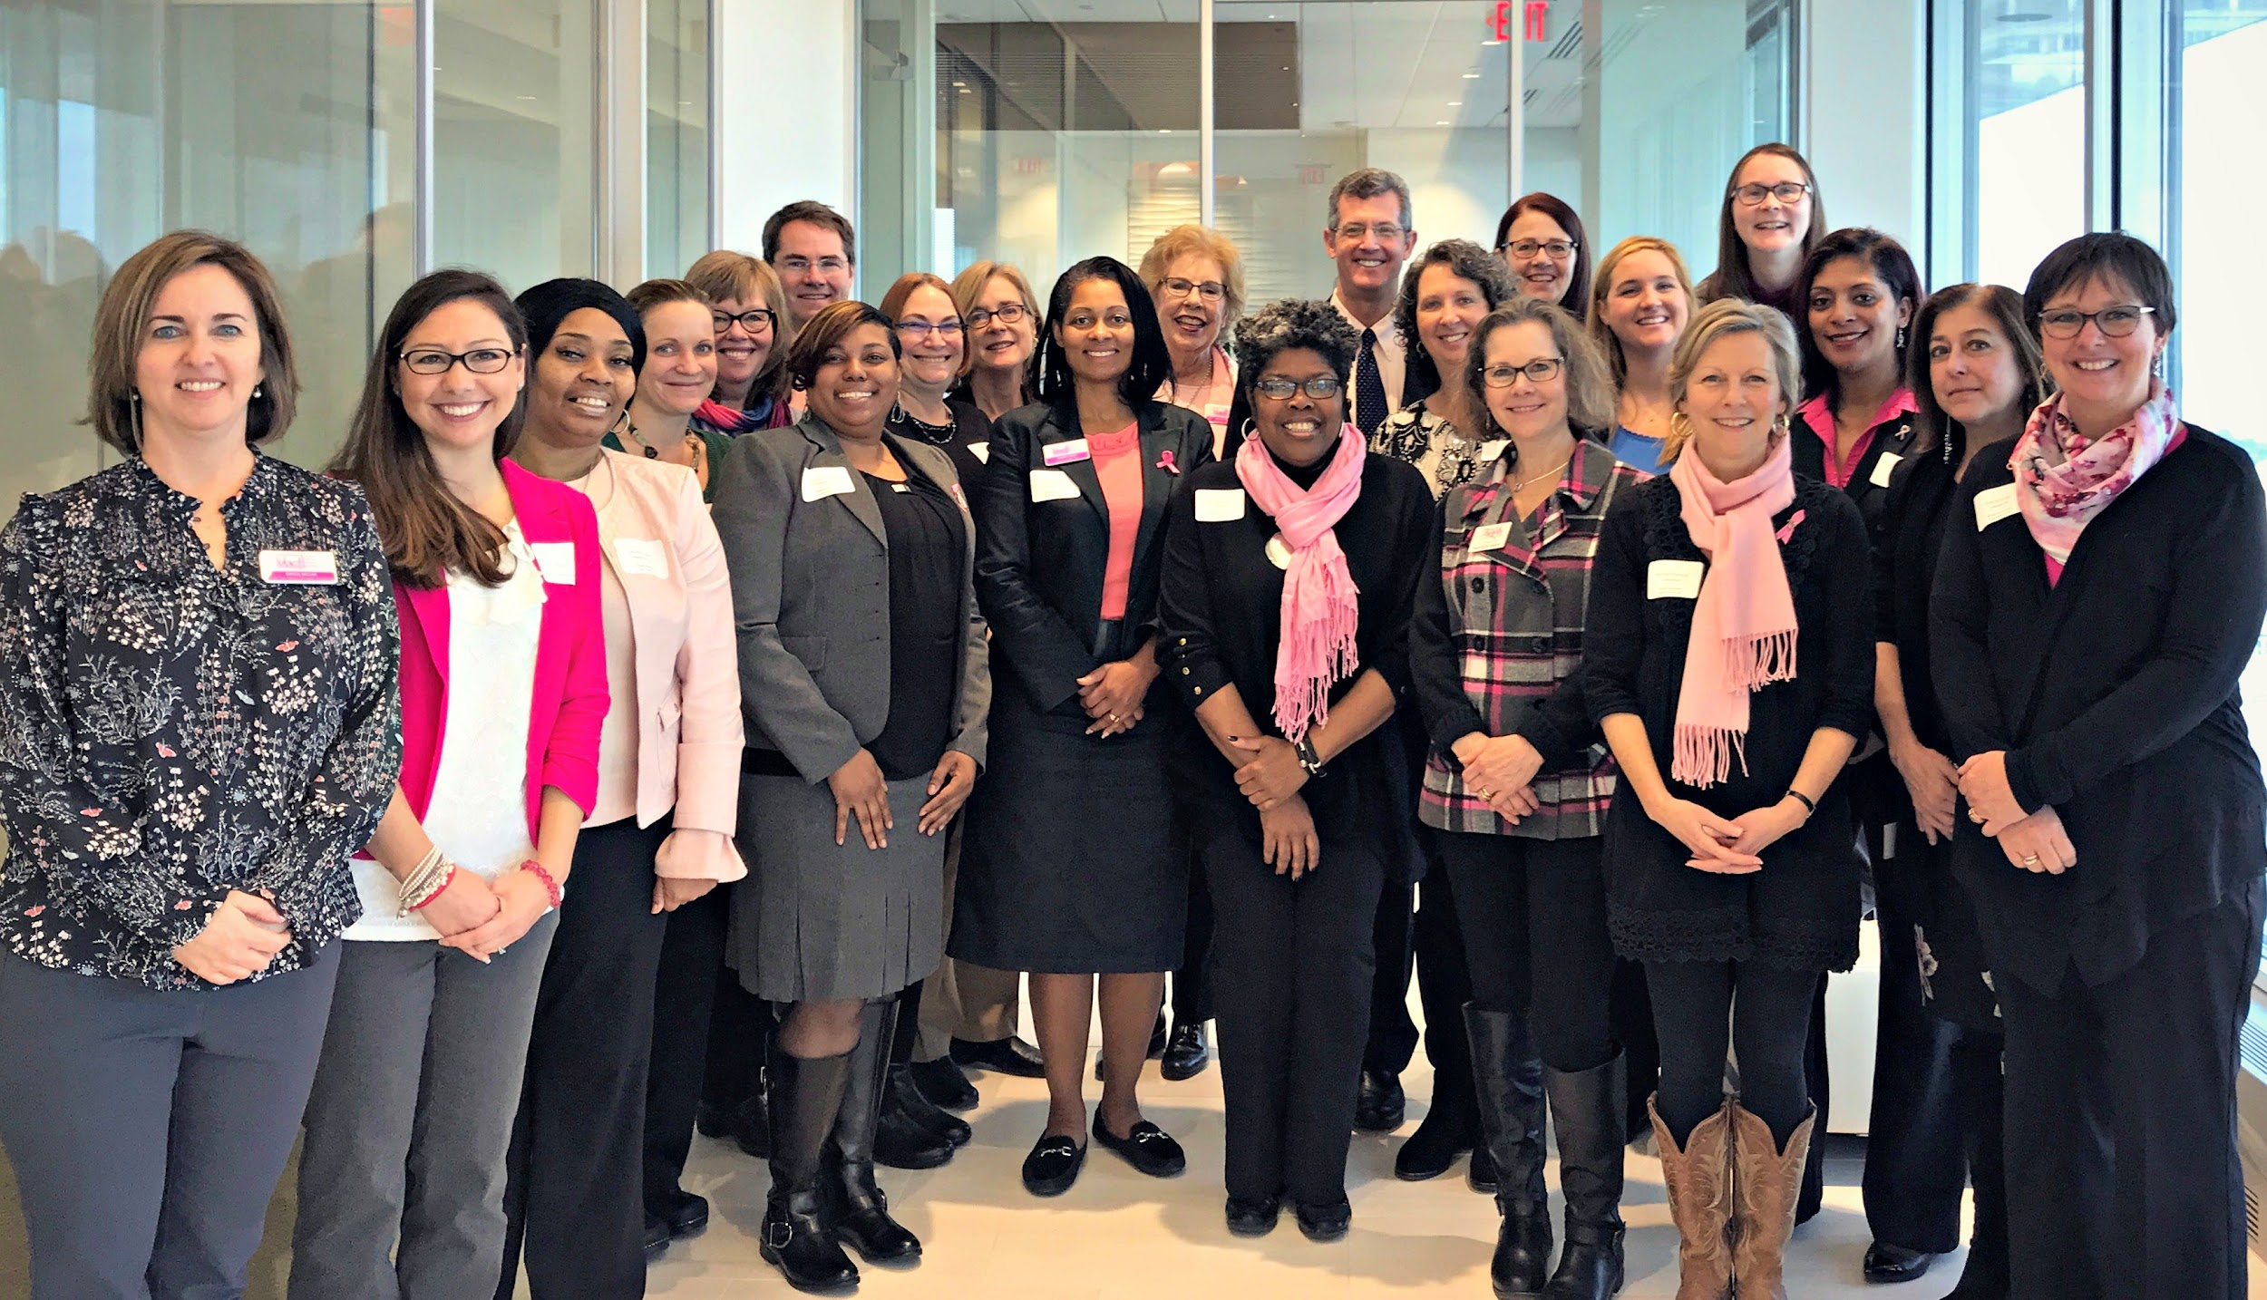
Advocacy
Notes:
Advocacy – We work to fight breast cancer on a state and national level. Every year VBCF members hold an Annual State Advocacy Day where we visit our VA Representatives and Senators and advocate for key breast cancer issues.
Every year VBCF also takes a bus of advocates to Washington D.C. for one day of intensive advocacy with people from all over the United States. Meetings are scheduled with the Virginia Senators and all Representatives. VBCF members sit down and talk to our delegates in small groups to EDUCATE these lawmakers of OUR concerns and issues.
2018 Win: “Let Doctors Decide” Access to medical cannabis oil!

Slide 35
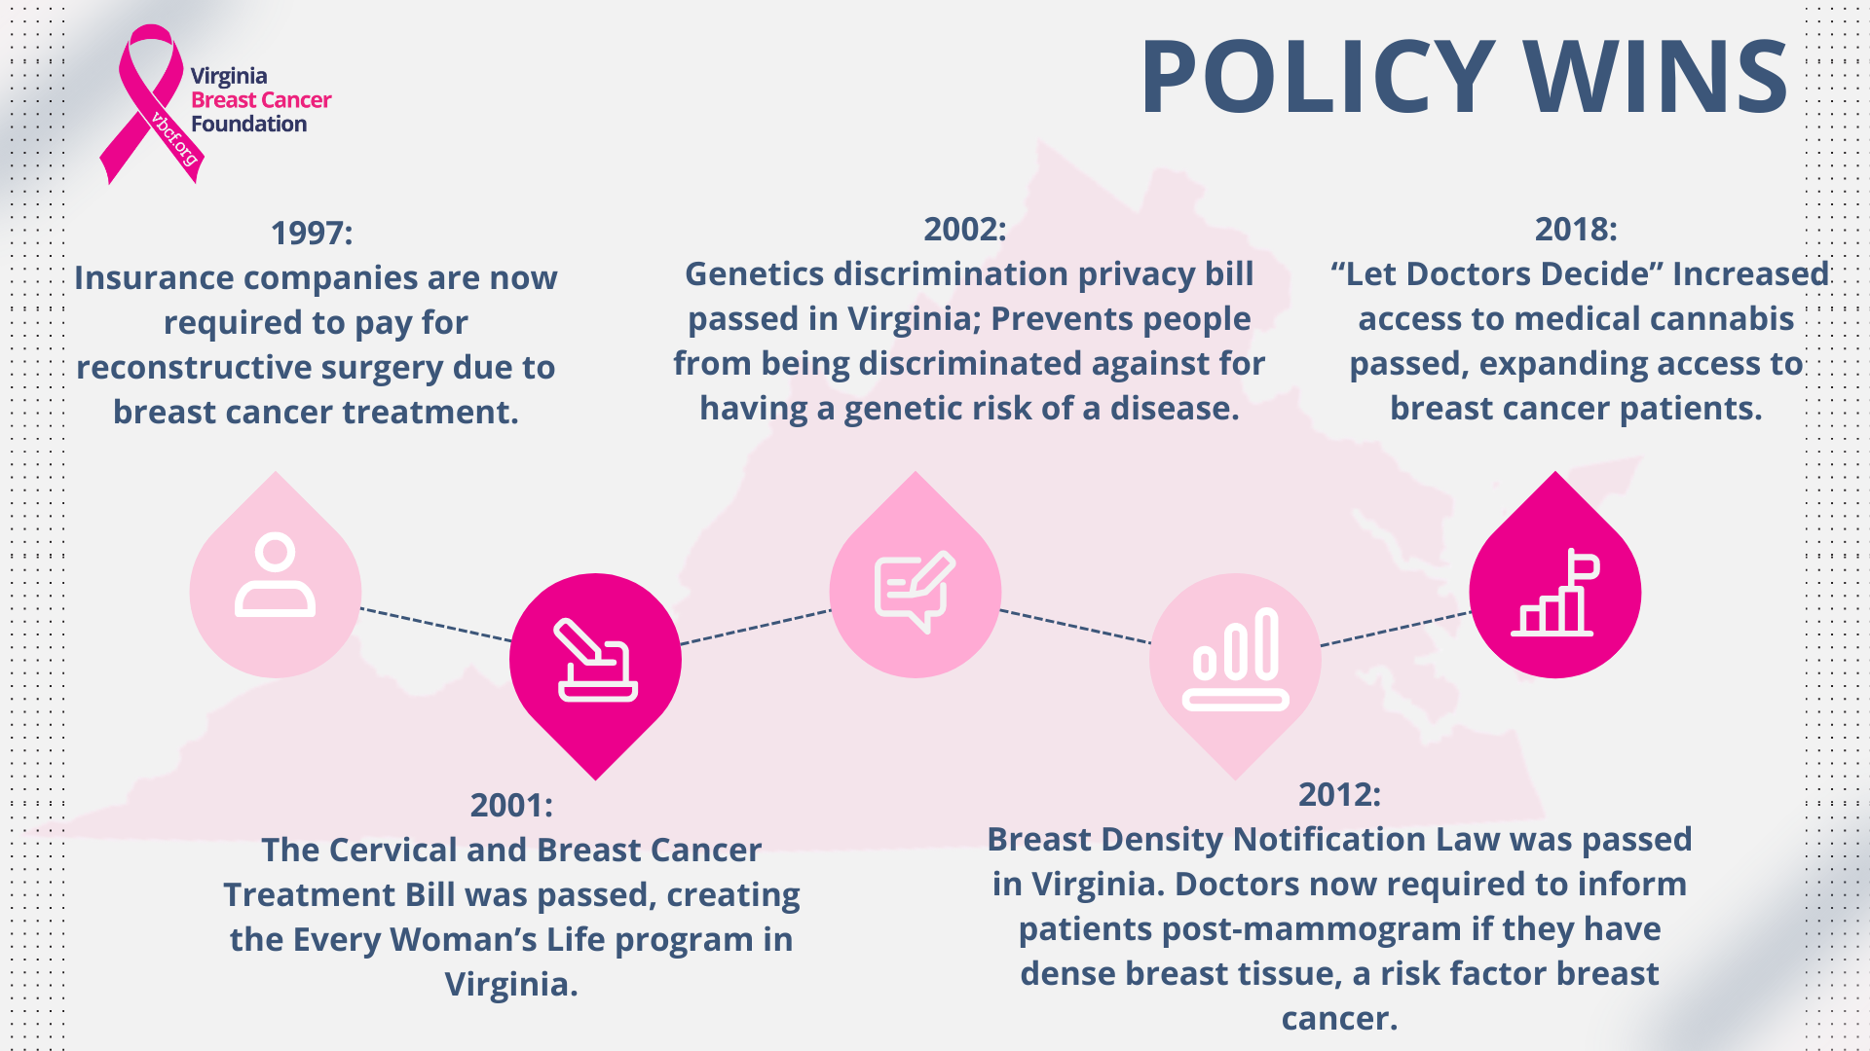

Slide 36
Join the Fight! Volunteer -
YOU CAN make a difference!
www.vbcf.org | 800-345-VBCF
Notes:
Help VBCF achieve our goals – there is something for everyone!
Join us at our state and national lobby days
Volunteer your time – serve on a committee, join a chapter, join our Speakers Bureau program if you are a survivor or have been affected by breast cancer, help raise awareness locally, help us raise funds, etc.
Distribute educational materials
Make a donation – VBCF accepts in memory of and in honor of donations, general donations, special event proceeds, etc.
get a pink ribbon license plate
(Add in quilt stuff when launched)
All funds donated to VBCF stay in Virginia to help Virginians
VBCF will make good use of your time, talents and treasures. Join VBCF today and help us fight breast cancer!

Slide 37
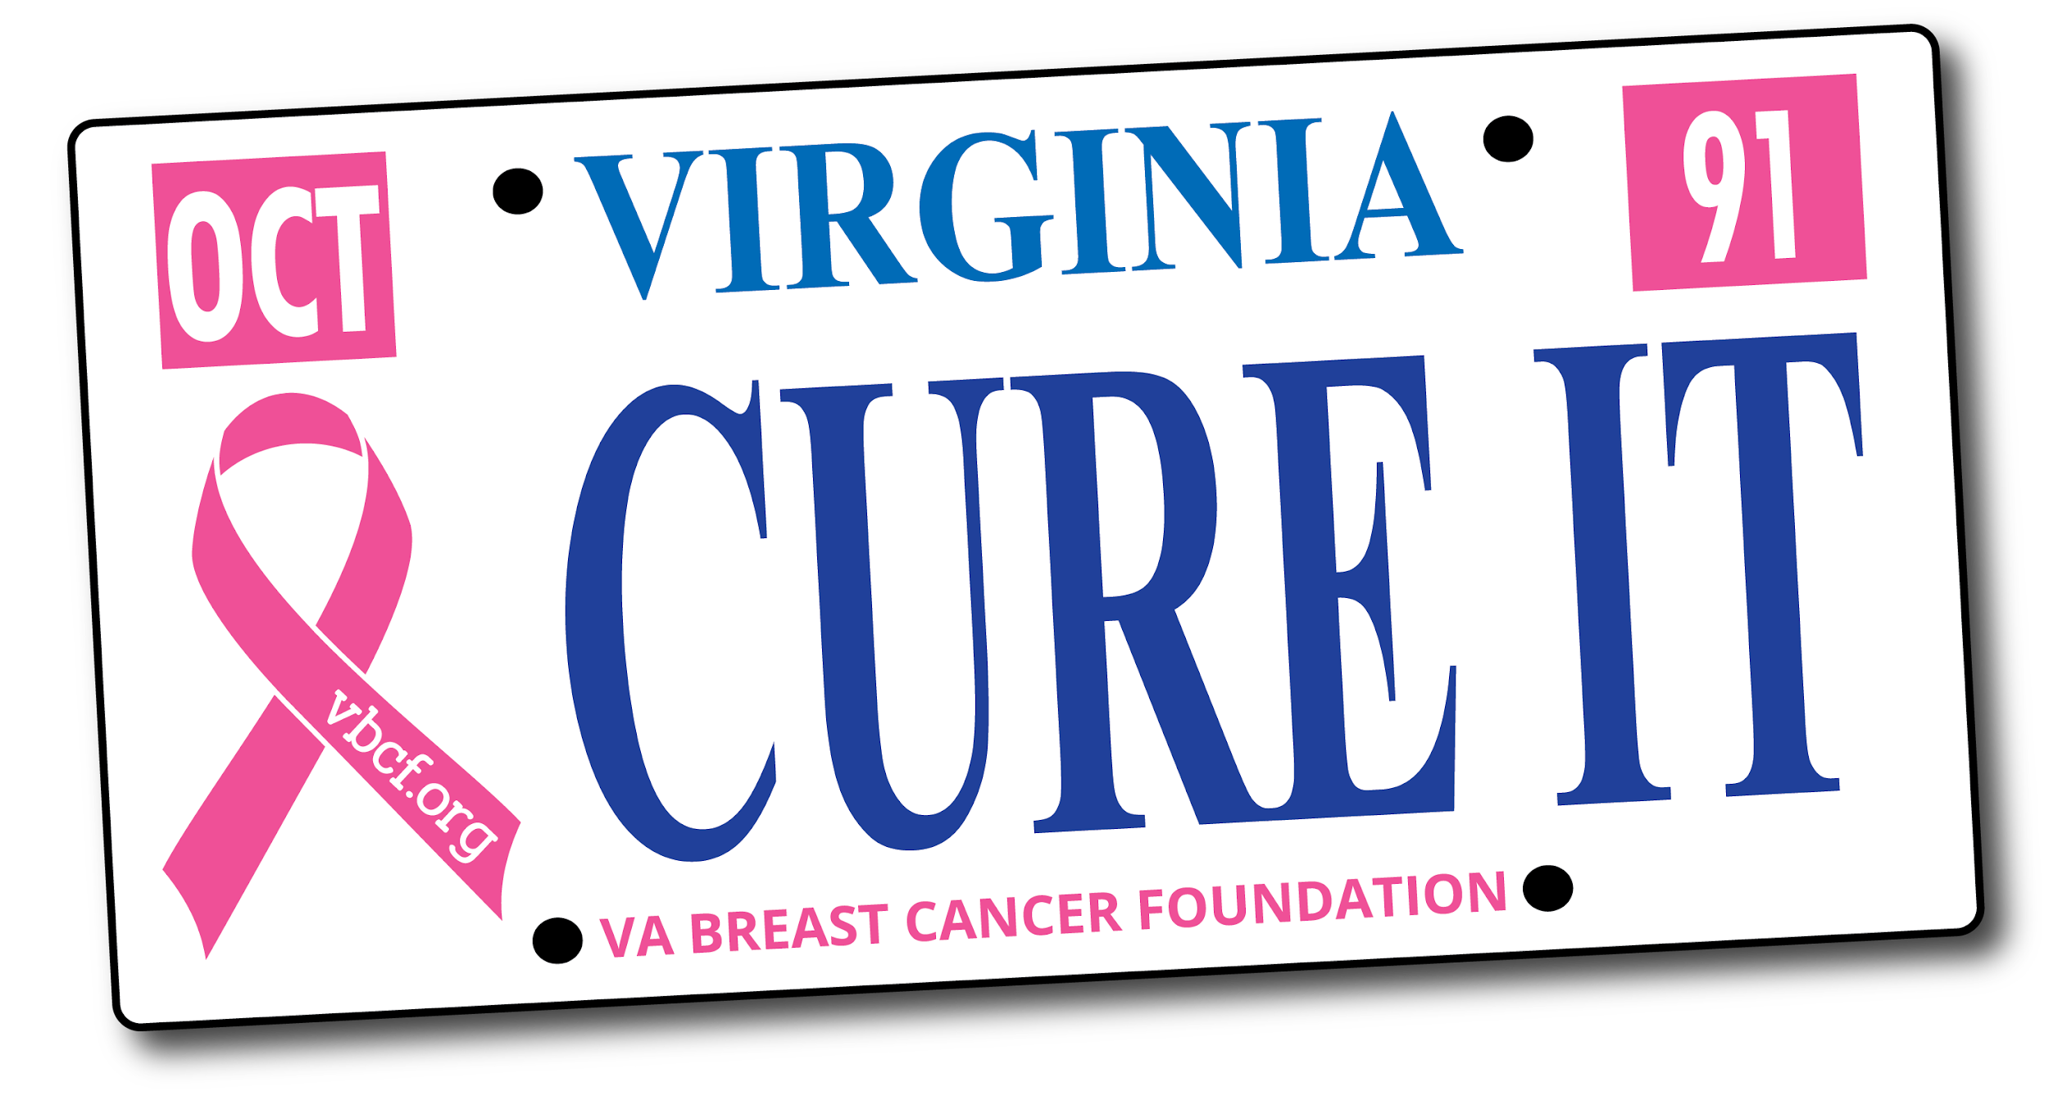
Available at the DMV now!

Slide 38
Thank you! Questions?
Erin Steigleder, MSW
(804) 285-1200
erin@vbcf.org

