Slide 1
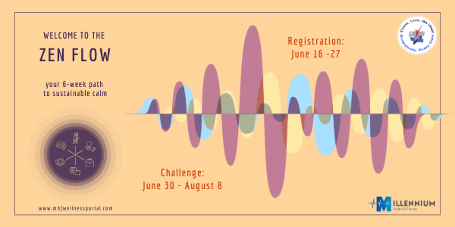

Slide 2


Monday Morning Tip-Off

Slide 3
Practice Critical Thinking: Regularly question assumptions, seek multiple perspectives, and analyze information before drawing conclusions.
When faced with a challenge, how do you use critical thinking or problem-solving skills to reduce your stress?

Slide 4
Engage in Brain Training: Use puzzles, memory games, or apps like Lumosity or Elevate to sharpen cognitive functions like attention, logic, and problem-solving.
Have you noticed any connections between lifelong learning and your resilience to stress?

Slide 5
Read Widely and Regularly: Read books, articles, or research from a variety of subjects to expand your knowledge and improve comprehension and vocabulary.
In the chat, please share:
Your most recent read.
Your most valuable/important read.
Your next planned read.
* Audiobooks count too!

Slide 6
Learn a New Skill or Language: Challenging your brain with unfamiliar activities helps build new neural connections and enhances cognitive flexibility.
Use the Feynman Technique: Learn a concept deeply by explaining it in simple terms to someone else (or yourself), identifying gaps in your understanding.
Practice Mental Visualization: Improve memory and planning by visualizing outcomes, processes, or concepts vividly in your mind.
Apply the Pomodoro Technique: Improve focus by working in short, timed intervals (e.g., 25 minutes) followed by brief breaks, keeping your mind sharp and engaged.

Slide 7
Stay Curious: Ask “why,” “how,” and “what if” questions throughout your day. Curiosity drives exploration and deeper learning.
Reflect Daily: Take time to review your day, what you learned, and how you responded to challenges. Journaling can support this reflective practice.
Connect Ideas Across Domains: Make a habit of linking new knowledge with what you already know—this strengthens memory and fosters creative thinking.
What’s something that you’ve learned within the past 24 hours? Can you summarize it in one sentence in the chat? (No one else needs to understand your summary- just you.)

Slide 8
What types of information or news tend to increase your stress, and how do you manage your exposure to them?

Slide 9
That lifestyle…
How do you challenge your own assumptions or beliefs when stress arises?
In what ways does curiosity help you find creative solutions to problems that cause you stress?
What new intellectual habit could you develop to better manage your daily stress level?

Slide 10
How does your approach to learning from mistakes influence your resilience?

Slide 11
Go deeper…
How do you balance the pursuit of new knowledge with the need to rest your mind during stressful periods?
Can you identify any patterns in your thinking that tend to increase your stress, and how do you work to shift them?
When you’re under stress, how do you stay open to new ideas or perspectives rather than becoming rigid in your thinking?

Slide 12
10 Proven Practices to Manage Intellectual Stress
Read Widely and Regularly: Explore books, articles, or journals on diverse topics—better yet, read about a topic that interests you or is brand new to you.
Solve a Puzzle or Brain Teaser: Challenge your mind with a crossword, Sudoku, or logic puzzle.
Attend a Webinar or Lunch-and-Learn: Participate in a session on a professional or personal growth topic.
Try a New Skill: Learn a new language (fire up Duolingo!), a new keyboard shortcut, have fun with Canva, or try a new hobby—even a short online tutorial can spark passion and interest!
Engage in Creative Expression: Draw, paint, write, crochet, craft, or try another creative activity to stimulate your mind.
Practice Mindful Learning: Focus deeply on a single task or topic for 10–15 minutes without distractions.
Pattern Recognition Games: Play games that require identifying patterns or sequences, such as SET or tangrams.
Reflect on a Recent Learning Experience: Journal or use your storytelling skills to reflect on your experience, what you learned, and how you can apply it.
Play a Strategy Game: Chess, checkers, or other games that require planning and critical thinking. Dust off Battleship!
Watch a Documentary, Educational Video, or Enroll in a Class: Choose a subject outside your usual interests for a fresh perspective.

