Slide 1
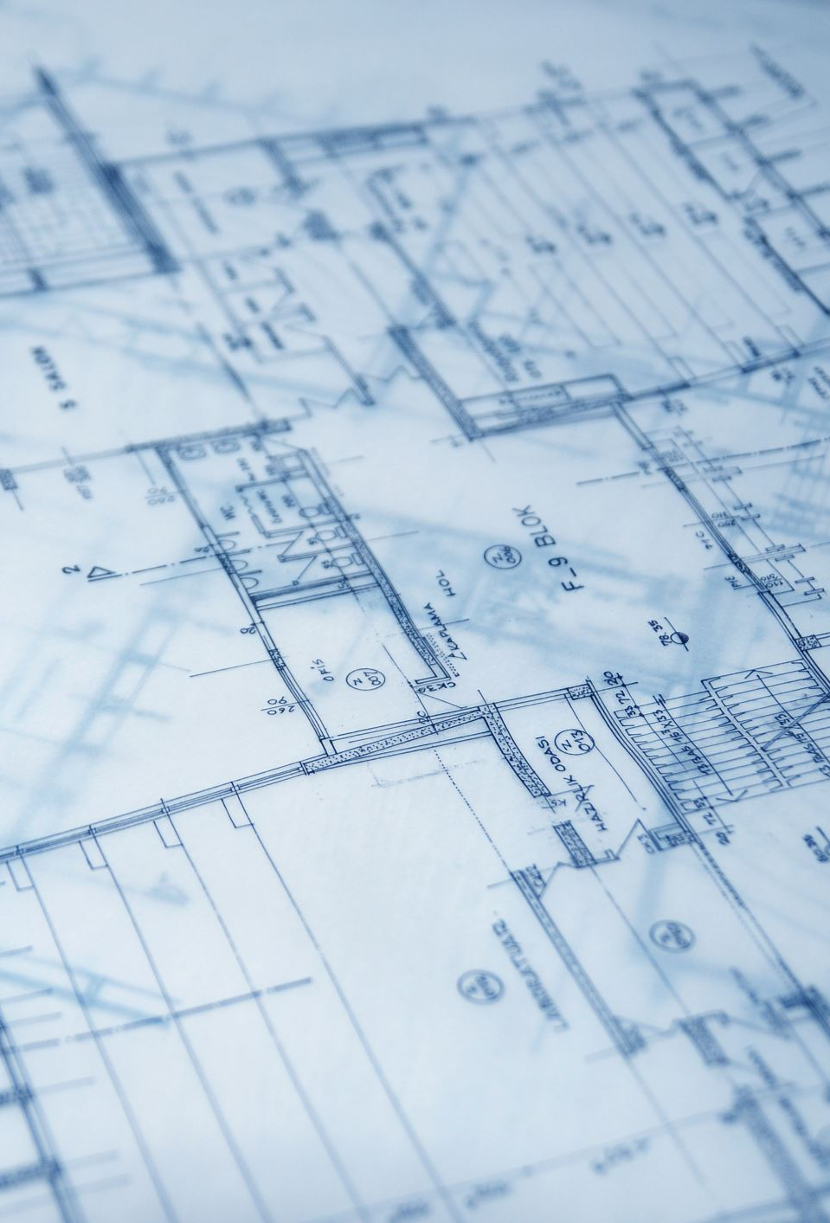
Balance Blueprint Building Better Boundaries
Emotional Wellness

Slide 2
Defining Boundaries in Emotional Wellness
Boundaries are limits we set to protect our emotions, energy, and mental space.
Emotional wellness depends on having healthy boundaries that allow us to feel safe, respected, and balanced.

Slide 3
Boundaries prevent Emotional Overload
Saying “No” helps reduce stress and prevents burnout.
Without boundaries, we may take on others’ problems or responsibilities at the expense of our own well-being.
Will my people pleasers in the room please stand up!
Clarify what you are not willing to tolerate (e.g., disrespect, constant negativity, overcommitment).
Must have an action plan
If “this”, then “this”
Example: If you call me names during an argument, I will step away, and we can discuss this later
Be specific with yourself about where your emotional “line” is.

Slide 4

Self Awareness and Emotional Health
You must understand yourself to establish healthy emotional boundaries.
Being aware of triggers allows us to set protective limits (e.g., avoiding toxic conversations or environments).
Identify your emotional needs and limits (e.g., how much alone time you need, what drains your energy).
Pay attention to feelings of resentment, stress, or overwhelm — these are signs that boundaries may be needed.

Slide 5
Healthy Communication
Boundaries encourage clear, respectful communication of needs and feelings.
They teach others how to treat us and prevent resentment from building.
Use “I” statements to express your needs (e.g., “I need some time to recharge after work before talking about stressful topics.”).
Be direct but respectful — clarity prevents confusion and builds trust.

Slide 6
Healthy Communication
Saying “No” is not rejection; it’s self-care.
You don’t need to over-explain — a simple “I can’t commit to that right now” is enough.
New boundaries need time to be established
Have the courage to talk about why a new boundary is needed and how you will respond if a boundary is crossed
Setting a boundary is difficult but it will also seem like you are changing the rules of the game to other involved.
There will need to be a break in period for the new playing field

Slide 7
Protecting Time and Energy
Emotional wellness improves when we guard our time for rest, reflection, and self-care.
Boundaries help us prioritize supportive relationships over draining ones.
How many relationships in your life lift you up versus pull you down?
Limit how often or how long you engage in draining conversations.
Social media……………
Decide when you are available for others and when you need solitude.

Slide 8

Respecting Personal Space and Privacy
Emotional health grows when we feel our privacy, opinions, and choices are respected.
Boundaries establish that our inner world is valuable and worth protecting.
Do you have a space in your home that you can be alone?
If not, can you communicate with those in your life when you need time to yourself?
Boundary Thought: Do you need solitude or space?
True me time or a break from familiarity?

Slide 9
Relationships and Emotional Balance
Healthy boundaries build trust and mutual respect in relationships.
Understand new boundaries will require good communication and patience
They prevent codependency by allowing each person to take responsibility for their own emotions.
Step away from toxic or overly demanding interactions.
Use, if “this” then “this”
Use coping strategies like journaling, meditation, or therapy to reinforce boundaries internally.

Slide 10

The Ripple Effect
Strong emotional boundaries reduce anxiety, improve self-esteem, and foster resilience.
They create a safe emotional environment that allows joy, calm, and connection to flourish.
Healthy boundaries are mutual — just as you set your limits, listen and respect the boundaries of others.
This reciprocity strengthens relationships and emotional wellness.

Slide 11
Effective vs. Non-Effective
Scenario #1
The Overshare Spiral

Slide 12
Effective vs. Non-Effective
Scenario #2
The Fix It Reflex

Slide 13
Effective vs. Non-Effective
Scenario #3
The Energy Borrower

