Slide 1

Balance Blueprint Building Better Boundaries
Social Wellness

Slide 2

Understand Social Wellness Needs
Social wellness is about having healthy, supportive, and respectful relationships.
Relationships vary in many ways
Safety
Connection
Emotionally
Values
Healthy social boundaries protect your limited individual resources and help improve your overall wellness

Slide 3
How Much
For most people it can be difficult to set social boundaries
If you say “Yes”, you may be giving too much of yourself
If you say “No”, you may be robbing yourself of experiences and joy
To aid in developing healthy boundaries, ask yourself “How Much?” when assessing your social relationships
We are all capable of giving of ourselves to others
Asking “How Much” is a great way to assess the amount of your personal time and energy you are willing to give to any given individual

Slide 4
How Much
Group your social relationships into a target
Those in the Bullseye are your most intimate relationships
Immediate Family, Spouse, etc.
They get access to most of your time, energy, and resources
All other social boundaries are going to be created with these relationships in mind
Intimate Relationships
Close Relationships
Strangers or Acquaintances

Slide 5
How Much
The second ring are your close relationships
Best friends, extended family, long term coworkers, etc.
They get access to your resources but not at the expense of those in the bullseye
You would set boundaries with your close relationships to protect your intimate relationships
Intimate Relationships
Close Relationships
Strangers or Acquaintances

Slide 6
How Much
The outer ring is strangers and acquaintances
They have the least access to your resources and never at the expense of your close and intimate relationships
Keep in mind, people can fall in and out of different rings depending on your ever-changing life
Intimate Relationships
Close Relationships
Strangers or Acquaintances

Slide 7

Protect Time and Energy
There are times where we need space and time to ourselves
Boundaries can help protect both your time and energy
Decide how much time you want to spend socially versus alone or with family.
Limit exposure to activities, groups, or conversations that feel as if they pull you away from your values and intimate relationships.

Slide 8
Communicate Clearly and Respectfully
Express needs openly
“I can’t stay late tonight”
“I need some quiet time to recharge”
“I am spending time with my spouse this weekend”
Clear communication helps others understand and respect your boundaries.
You own your boundaries, if someone continues to push your boundaries, it is time to assess whether that relationship is healthy for you to stay in

Slide 9
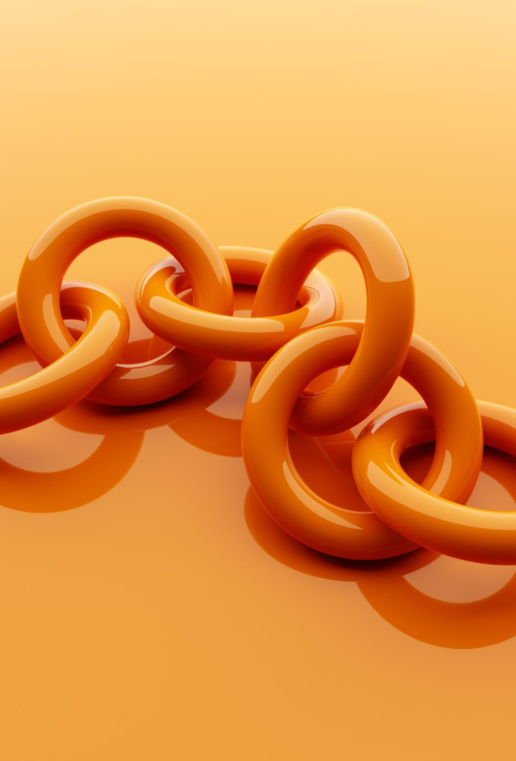
Set Emotional Safety Boundaries
Avoid oversharing if it makes you uncomfortable.
Boundary thought: What type of information would you be willing to share with those in the target example from earlier? Bullseye? Second Ring? Outer Ring?
Step back from gossip, negativity, or conversations that violate your values.
Boundaries protect your emotional well-being within social circles.

Slide 10

Digital and Social Media Boundaries
Limit social media, notifications, or constant availability to preserve mental space.
Presence is a key factor in maintaining healthy social relationships
You Physical Presence! Not your social media Prescence!
Be selective about who you connect with online and what content you engage in.
Most individuals you will engage with on social media are going to fall in the outer ring of our target.
They should be getting the least amount of your time and energy!
The Algorithm is going to push your boundaries!

Slide 11
Balance Support with Independence
Be supportive of friends and family but avoid becoming overly responsible for others’ problems.
Use your social target to judge how far you are willing to go to support someone
Drama is magnetic! Only get pulled into the problems of those that mean the most to you in life
Boundaries mean recognizing where your role ends and theirs begins.
Boundary in Balance:
Your close friend calls you consistently at bedtime to vent about their day. This has become a stress on quality time with your spouse and infringed on your sleep routine. How could you set a boundary with your friend to respect time with your spouse and ensure quality sleep?

Slide 12
Effective vs. Non-Effective
Scenario #1
The Overcommitment Cycle

Slide 13
Effective vs. Non-Effective
Scenario #2
The Gossip Loop

Slide 14
Effective vs. Non-Effective
Scenario #3
The Energy Drain Chat

